Slide 1
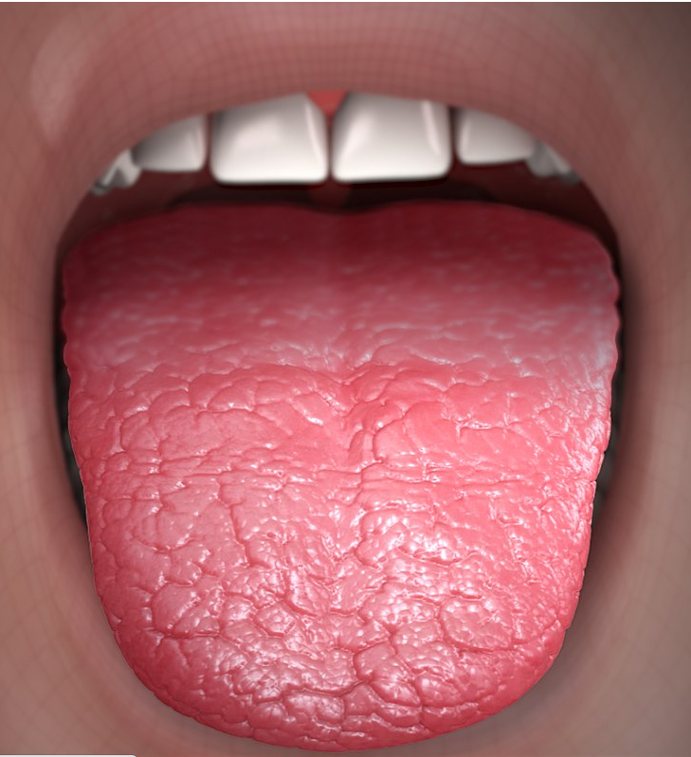
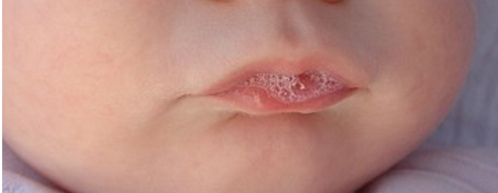
Xerostomia
And
Hypersalivation / Sialorrhea
Harry Hoffman MD
U of Iowa
COI:
Author - UpToDate
Research - COOK Medical
scientificanimations.com, CC BY-SA 4.0 , via Wikimedia Commons https://commons.wikimedia.org/wiki/File:Xerostomia_-_Dry_Mouth_(cropped).jpg < downloaded 4-30-2023>
Pereru, CC BY-SA 4.0 <https://creativecommons.org/licenses/by-sa/4.0>, via Wikimedia Commons

Slide 2
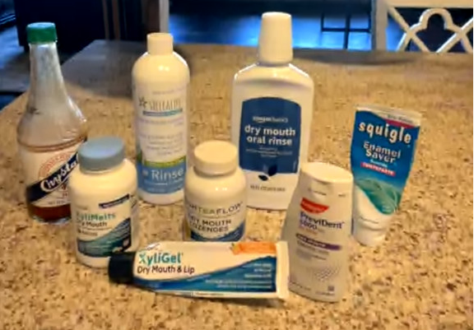
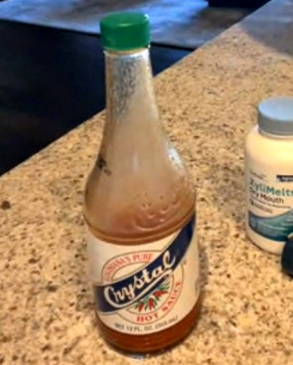
Xerostomia – risk factors
age / gender / hormone changes / autoimmune / radiation / dehydration / diabetes / / mouth breathing / infection /
alcohol / tobacco / caffeine / anxiety / snoring /
Sensation of oral dryness 'does not usually occur until the normal unstimulated flow rate is reduced by approximately 50% '

Slide 3
Dose-dependent association between xerostomia and number of medications among older adults.Storbeck T, Qian F, Marek C, Caplan D, Marchini L.Spec Care Dentist. 2022 May;42(3):225-231. doi: 10.1111/scd.12662. Epub 2021 Oct 13.PMID: 34644409
Xerostomia: "subjective feeling of having a dry mouth" (may or may not be associated with objective reduction)
Prevalence: older adults = 20% institutionalized older adults = 72%
Polypharmacy: nursing home survey: mean number of daily mediations taken = 9.8
Review of health history of 11,061 patients seen at U of Iowa Dentistry with health questionnaires retrospectively reviewed
(78.1% hypertensive,31.6% diabetic; 20.6% mental disorder)
38.5% reported dry mouth mean age = 74, median number of medications = 7
Finding: strong dose-dependent association between the number of medication and self-reported xerostomia
Xerogenic Medication
'58 drug categories and 71 subcategories of medications possibly cause xerogenic side effects'
Anti's: antidepressants (71%), antihypertensives (50%), antiretrovirals (35% )
Parkinson's disease dopamine agonists (50%)
Psychotropic drugs, diuretics, analgesics, antihistamines
Clindine, Methyldopa, Anticholinergics, Anti-epileptics
Barbe 2018; Hend 2021; Ogle 2020; Laugisch 2021, Villa 2015, Wolff 2017
# medications
relative risk
11+ | 4.94
7-10 | 2.58
4-6 | 1.48
0-3 | 1.00
Managing xerostomia and salivary gland hypofunction: executive summary of a report from the American Dental Association Council on Scientific Affairs.Plemons JM, Al-Hashimi I, Marek CL; American Dental Association Council on Scientific Affairs.J Am Dent Assoc. 2014 Aug;145(8):867-73. doi: 10.14219/jada.2014.44.PMID: 25082939
The impact of saliva on patient care: A literature review.
Diaz-Arnold AM, Marek CA.J Prosthet Dent. 2002 Sep;88(3):337-43. doi: 10.1067/mpr.2002.128176.

Slide 4
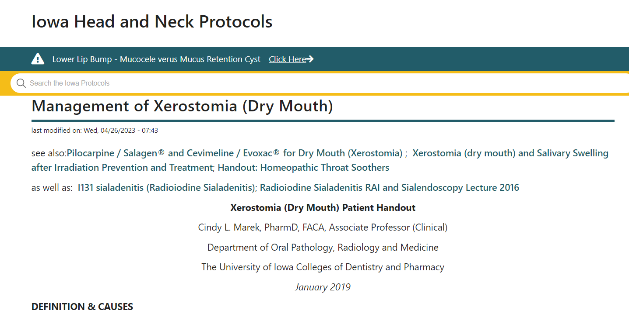

Slide 5
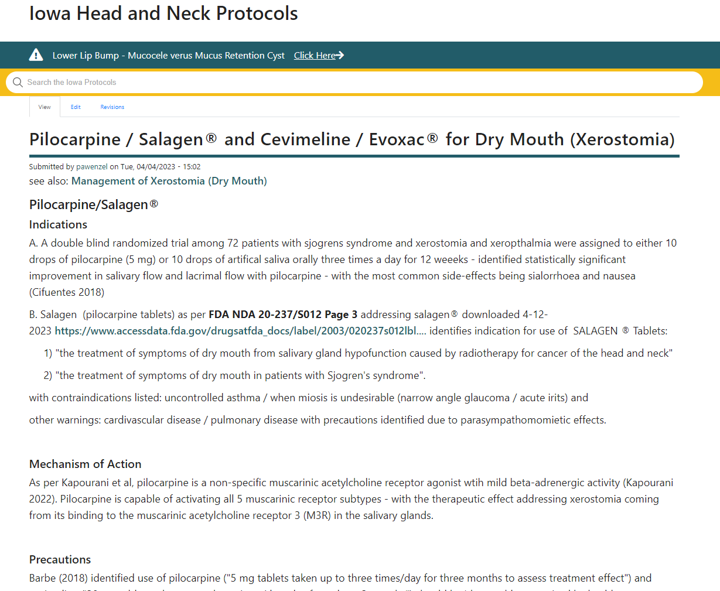
should be 'thoroughly supervised by healthcare professionals'
in older patients due to
'highly prevalent cholinergic side effects' including nausea, emesis, bronchoconstriction, bradycardia, hypotension and others".
concern about drug interaction with other medications including beta-adrenergic antagonists, antidepressants or clozapine.
Barbe AG. Medication-Induced Xerostomia and Hyposalivation in the Elderly: Culprits, Complications, and Management. Drugs Aging. 2018 Oct;35(10):877-885. doi: 10.1007/s40266-018-0588-5. PMID: 30187289

Slide 6
Recent patient with xerostomia (rheumatology note)
Treatment:
Suggestions for dry mouth:
-sour sugar free lozenges or gum. ACT makes a lemon lozenge for dry mouth. Xylimelt lozenges stick to teeth and are sometimes helpful.
- stay hydrated. Use humidifier in the winter.

Slide 7


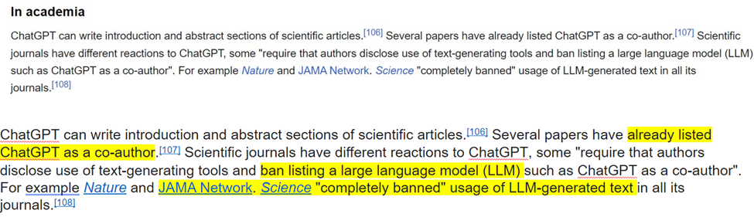
Recent patient with xerostomia (rheumatology note)
Treatment:
Suggestions for dry mouth:
-sour sugar free lozenges or gum. ACT makes a lemon lozenge for dry mouth. Xylimelt lozenges stick to teeth and are sometimes helpful.
- stay hydrated. Use humidifier in the winter.

Slide 8
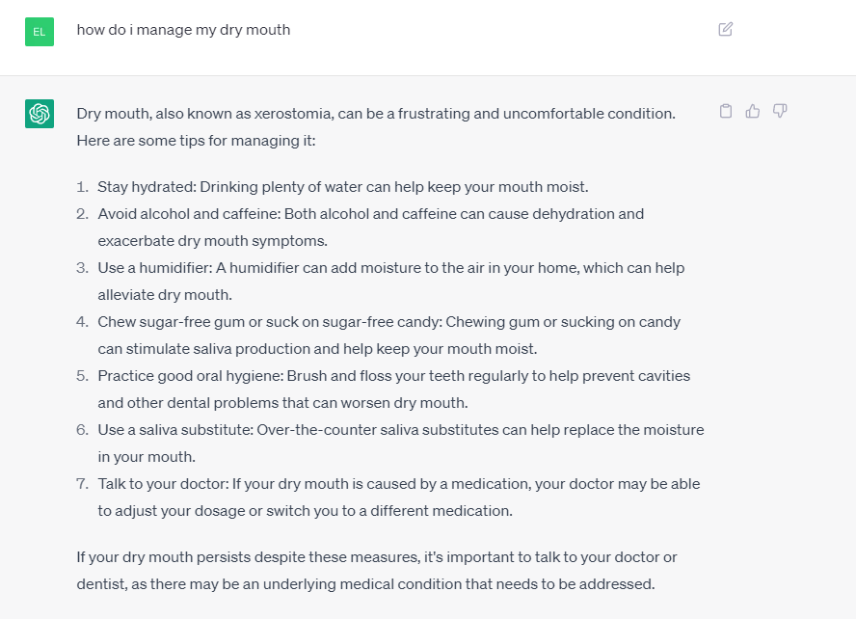

Slide 9
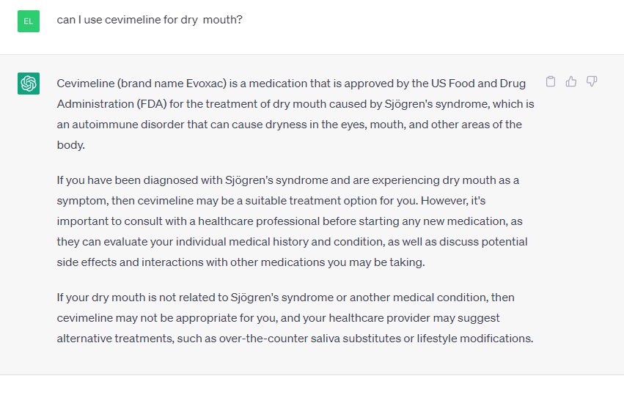
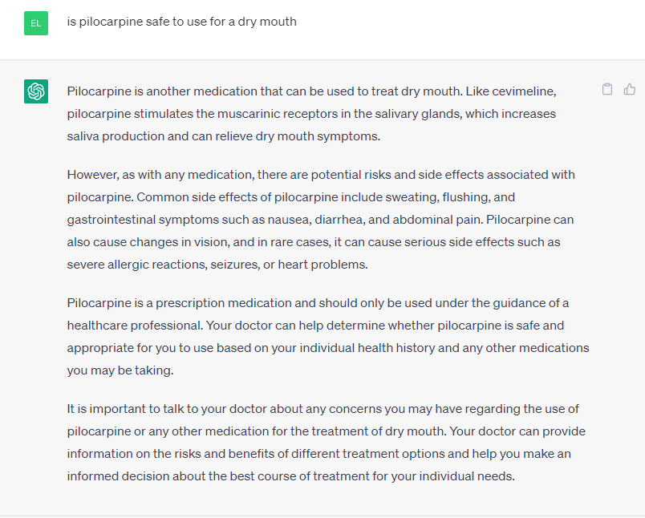

Slide 10
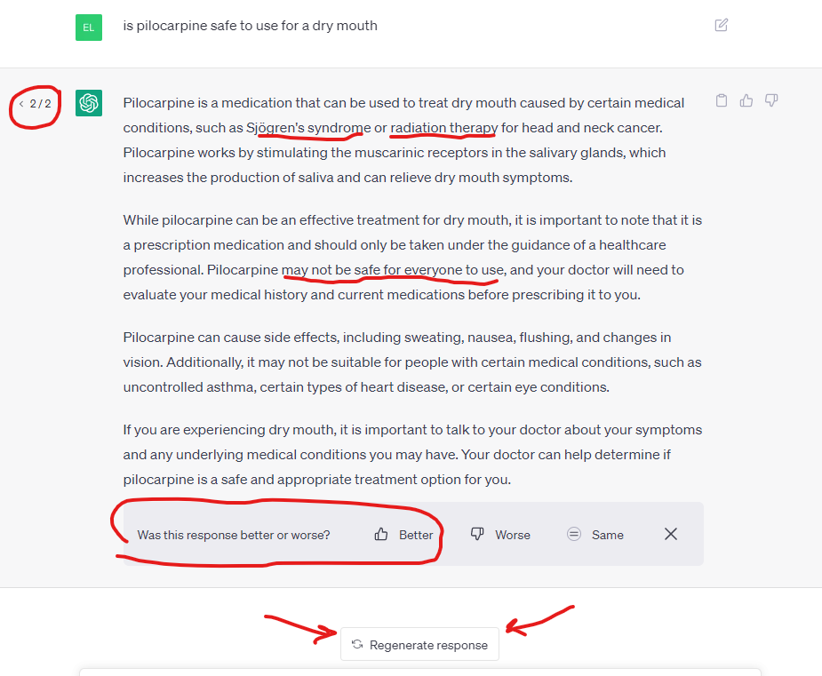

Slide 11
Xerogenic Medication
Medication-Induced Xerostomia and Hyposalivation in the Elderly: Culprits, Complications, and Management.Barbe AG.Drugs Aging. 2018 Oct;35(10):877-885. doi: 10.1007/s40266-018-0588-5.PMID: 30187289 Review.
Medication-induced xerostomia and hyposalivation will increasingly become oral health issues for older and geriatric patients because of the likely high prevalence of medication intake and polypharmacy, with a complex negative impact on other symptoms such as dyspha …
Salivary Gland Diseases.Ogle OE.Dent Clin North Am. 2020 Jan;64(1):87-104. doi: 10.1016/j.cden.2019.08.007. Epub 2019 Oct 10.PMID: 31735235 Review.
The interrelationship between xerogenic medication use, subjective oral dryness and tooth wear.Alwaheidi HAA, O'Toole S, Bernabé E.J Dent. 2021 Jan;104:103542. doi: 10.1016/j.jdent.2020.103542. Epub 2020 Dec 1.PMID: 33276080
In addition, participants taking one and multiple (two or more) xerogenic medications had, respectively, 1.53 (95 % CI: 1.01-2.32) and 1.44 (95 % CI: 0.62-3.33) greater odds of having tooth wear than those taking no xerogenic medications. ...CONCLUSION …
The relationship between cardiovascular xerogenic medication intake and the incidence of crown/root restorations.Maupomé G, Peters D, Rush WA, Rindal DB, White BA.J Public Health Dent. 2006 Winter;66(1):49-56. doi: 10.1111/j.1752-7325.2006.tb02551.x.PMID: 16570751
Records were extracted for all members who were at least 55 years old at the end of the 11 year window, and had at least 48 months of concurrent dental, medical, and pharmacy coverage. The authors identified 4448 individuals whose only xerogenic medication ex …

Slide 12
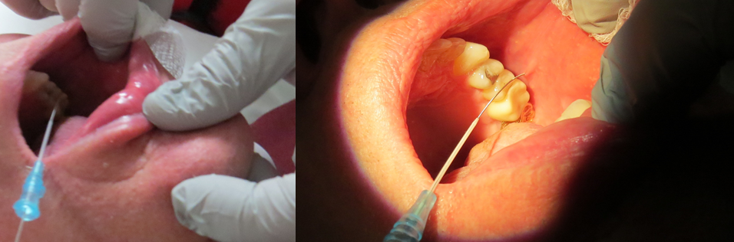
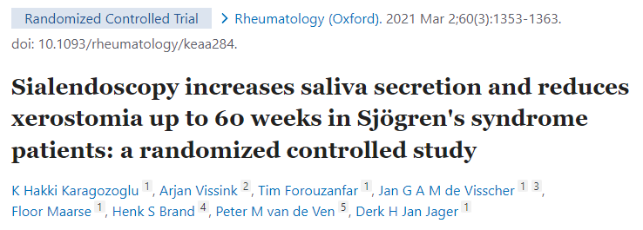
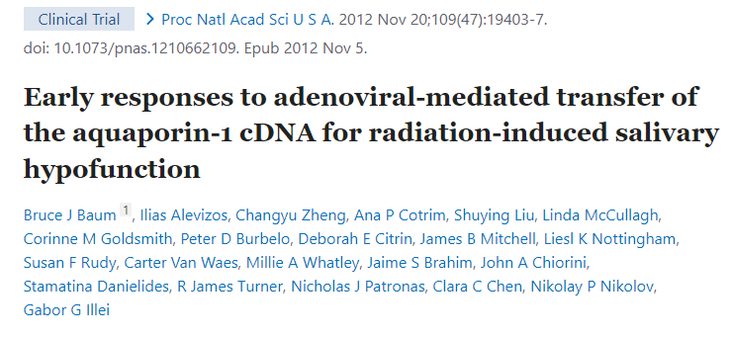
Xerostomia
Good News!
Forty-five patients with SS randomly assigned to
(1) a control group (no irrigation, control, n = 15),
(2) to irrigation of the major salivary glands with saline (saline, n = 15) (3) to irrigation with saline followed by corticosteroid application
Conclusion:
Irrigation of the major salivary glands in patients with SS increases salivary flow and reduces xerostomia.
began treating patients with AdhAQP1 in 2008 AdhAQP1 vector delivery to a single parotid gland was safe and transfer of the hAQP1 cDNA increased parotid flow and relieved symptoms in a subset of subjects.

Slide 13
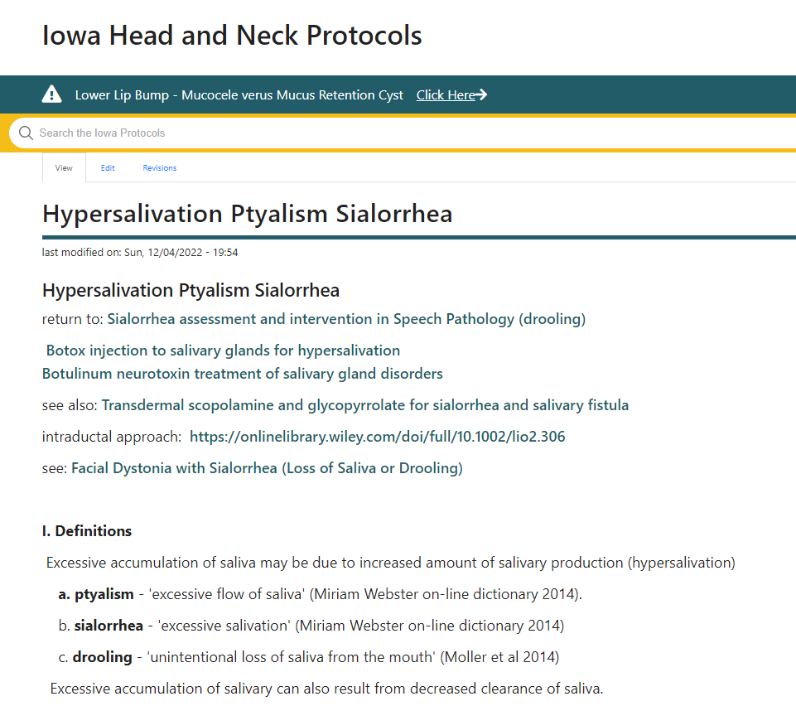
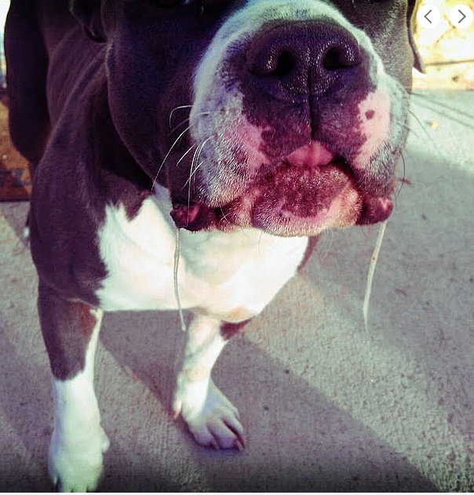
GutterStrife, CC BY-SA 4.0 <https://creativecommons.org/licenses/by-sa/4.0>,
via Wikimedia Commons
Pereru, CC BY-SA 4.0 <https://creativecommons.org/licenses/by-sa/4.0>, via Wikimedia Commons

Slide 14

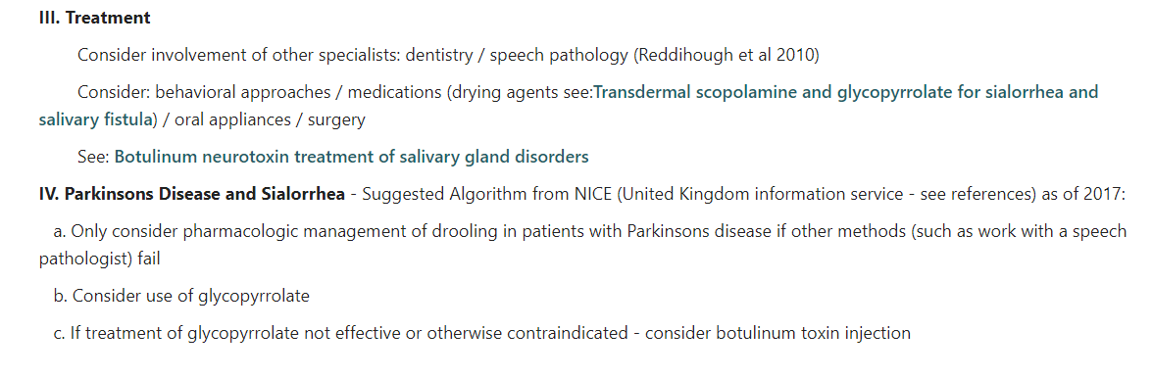
Optimizing Positioning coordinate with physical therapy); Oral Motor Exercises; Behavioral (increased swallowing frequency)

Slide 15
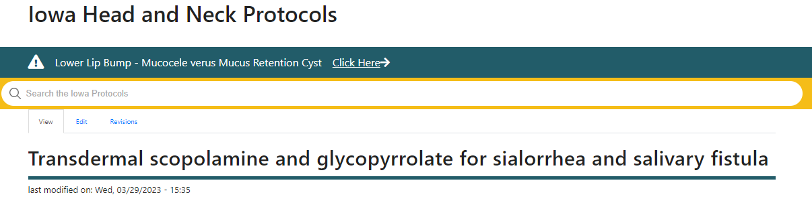
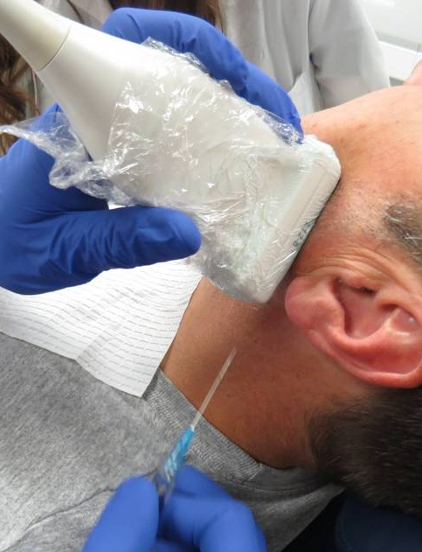
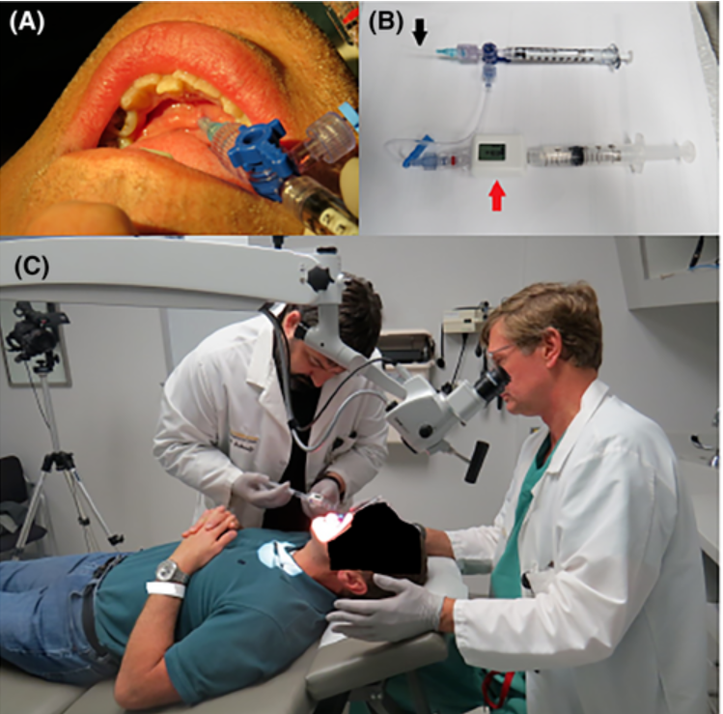
Merello et al identified in 2008 that "that the management of sialorrhea in PD [Parkinsons disease], it is proposed that glycopyrrolate should be evaluated before considering botulinum toxin injections" (Merello 2008).
A more recent publication identified Botulinum neurotoxin (BoNT) to be 'first line of pharmacotherapy for chronic sialorrhea' (Jost 2019)
Other Treatment
Amitryptilene
Sublingual atropine drops
Benztropine
Radiotherapy

Slide 16
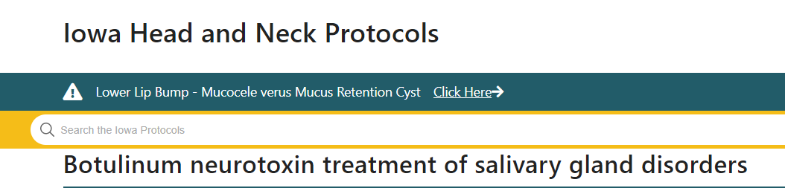
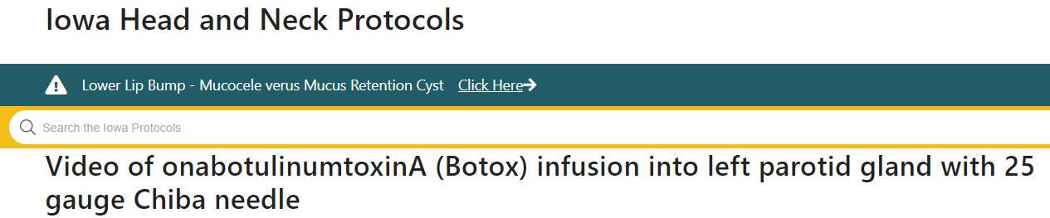
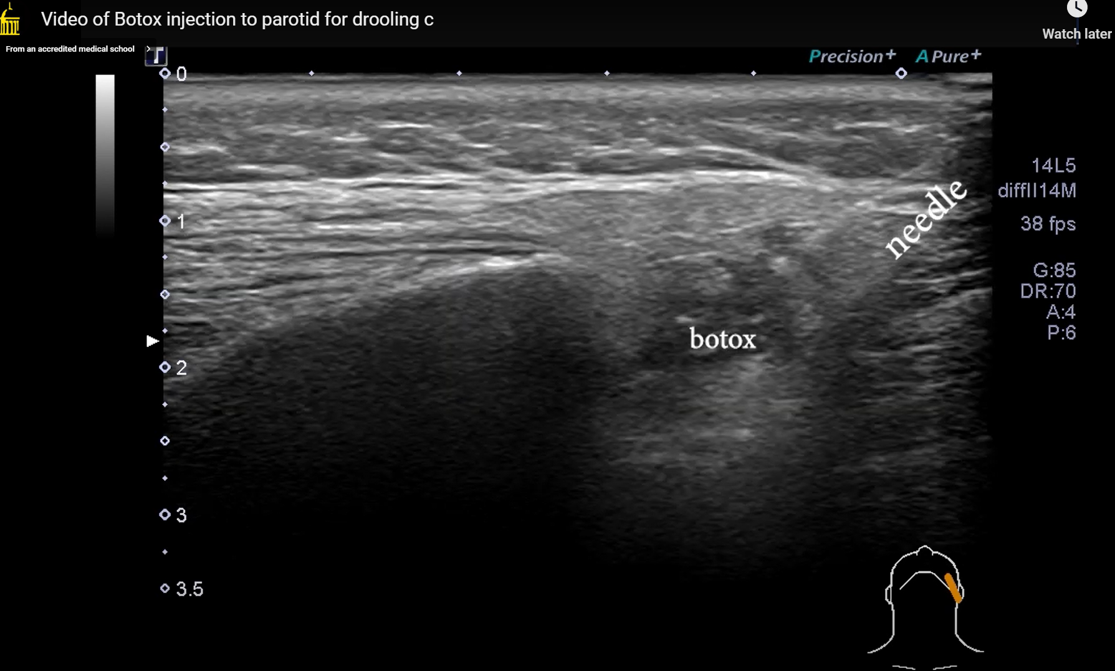
Conclusion
Website: XEOMIN® Dosing | Adults With Chronic Sialorrhea
FDA approved for sialorrhea – 30 units (parotid) 20 units (SMG) Contains a video demonstration
they "can't see the needle"
Sialorrhea
Sialocoele / Salivary Fistula
Frey's Syndrome
Prophylaxis prior to oral cavity resection
Recurrent parotitis
Adjunct to sialendoscopy
First bite syndrome
Obstructive parotitis
Disfiguring salivary gland enlargement
  "Lower face contouring" "Facial slimming"

