Slide 1
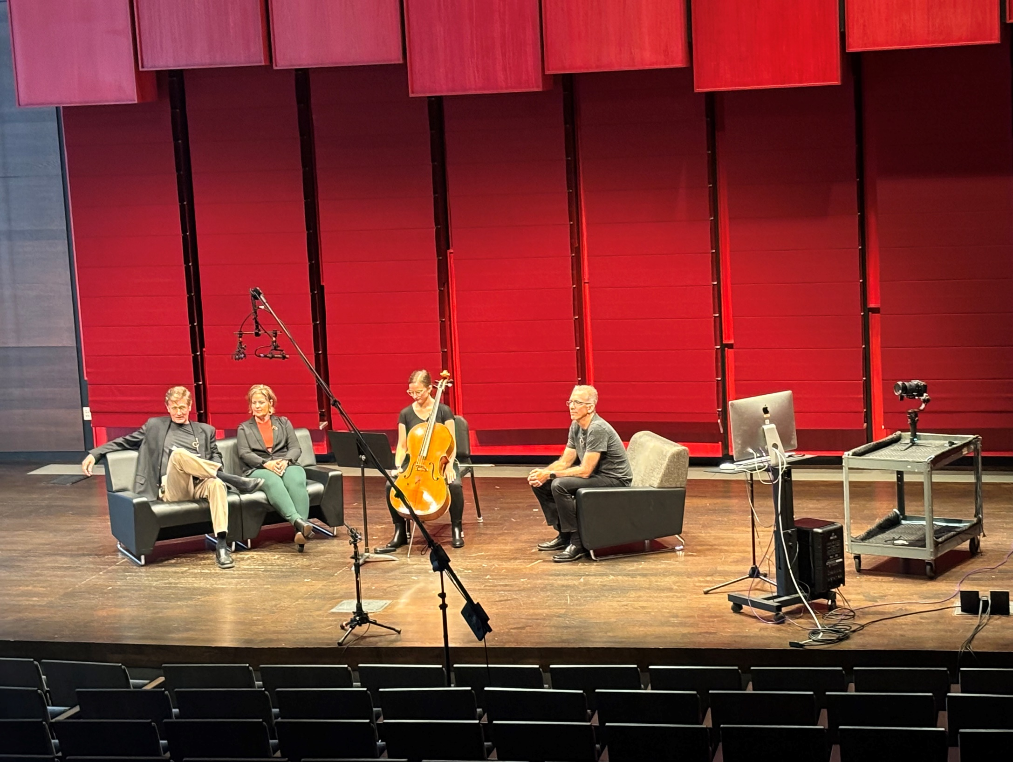
Music and Medicine on Monday
Podcast / Youtube
Webcast Series
Recorded in the
University of Iowa
School of Music

Slide 2
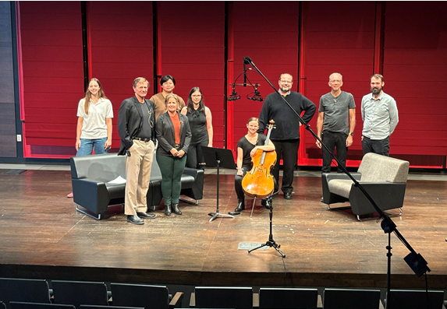
What?
Collaboration between
the
School of Music
and the
School of Medicine
University of Iowa
Each session focuses on a music/health issue
Each podcast is ~10 - 20 minutes long

Slide 3

Why?
To provide information to help musicians to play and stay healthy.
Expand visibility for the artistry and expertise in our Schools of Music and Medicine
Hosted on website (Iowa Protocols) also Youtube and Podcast

Slide 4
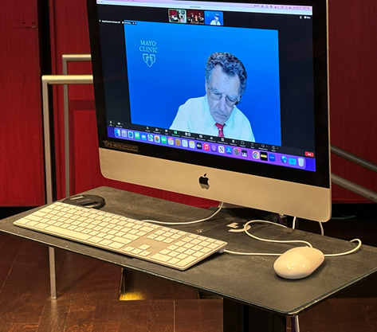
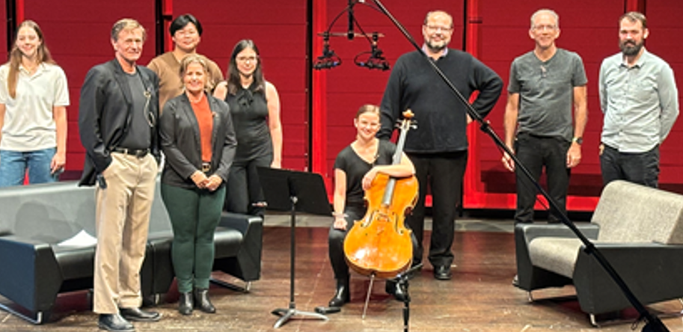
Who is in each podcast?
Guest experts may participate remotely
Harry Hoffman,MD UIHC, Podcast Host
Faculty member from School of Music
Student from that faculty member’s studio
Medical experts on specific topic
  [examples: Orthopedic Surgeon, Neuro-Otologist, Neurologist, Occupational Therapist, Physical Therapist, Psychologist, Audiologist, …]
James Edel and his team will coordinate recordings/editing

Slide 5
Format
Introduction of purpose and personnel
Meet the student as they describe why they chose to be a musician and their choice of instrument - describe equipment and musical piece they will play
Student plays 3-5 minutes of music to highlight demands of good musicianship
Discussion on the music-related health topic among the student, professor and medical personnel.
Closure highlighting more in-depth material on the Iowa Protocols:
Music and Medicine on Monday at the University of Iowa - Schedule of Events | Iowa Head and Neck Protocols (uiowa.edu)

Slide 6
Topics we have done
Posture demands for bass players
Physical demand of hands/arms of cellists
Embouchure dystonia in brass players
Hearing preservation for musicians

Slide 7
Future Topics
Hand and arm health in keyboard players, guitar, violin
Coping with tinnitus
Performance anxiety
Keeping your vocal mechanism healthy for a long career
Safe strategies for returning to singing after a respiratory or vocal infection
Making music with hearing aids, hearing loss
Neck and shoulder issues when playing violin/viola
OTHERS

Slide 8
To potential participating School of Music Faculty:
No need for existing medical problem. Discussion will center about potential risks, how to void them, and how to management them if they were to happen – such as possible risks associated with the extensive practice.
  One goal of the podcast. is to help prevent future problems.
  IF a faculty member has personal experience with a health concerns, and wants to share their experience, they may do so.

Slide 9
Preparation time and effort?
Selecting a student who is ready to play and who would by comfortable in a podcast; can use repertoire that student is planning for recital
An elective ~ 30 minute zoom meeting with Dr. Hoffman and team to plan presentation
~ 60-90 minutes of taping in the recital hall of VOX

Slide 10
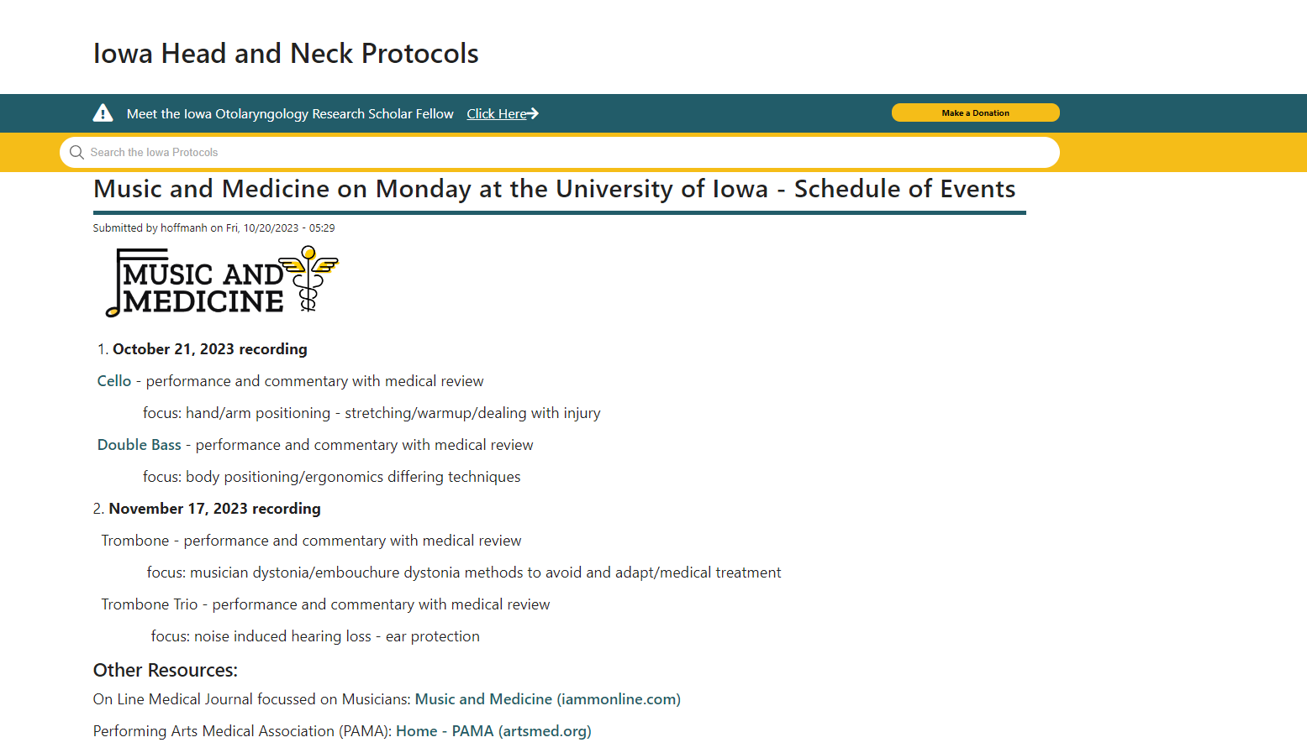

Contact:
(Harry) Henry Hoffman MD
Otolaryngology UIHC
200 Hawkins Drive, Iowa City 52242
henry-hoffman@uiowa.edu
319 321 7527

Slide 11
Approved logo
(Weds 11-29-2023 meeting with UIHC Art Director/Brand Manager)

Slide 12
