Slide 1
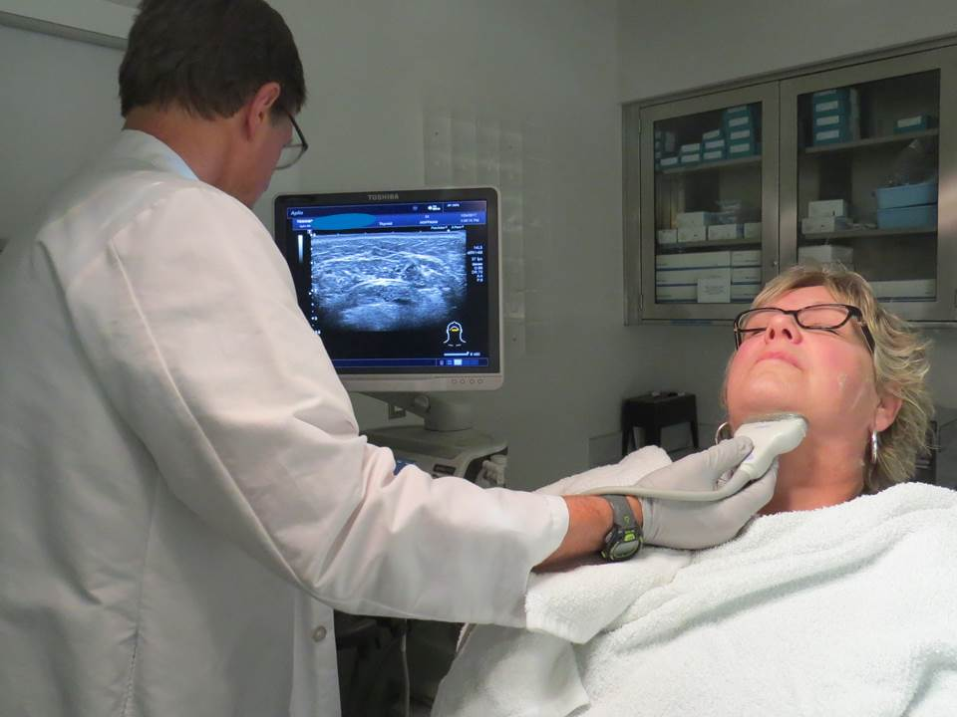
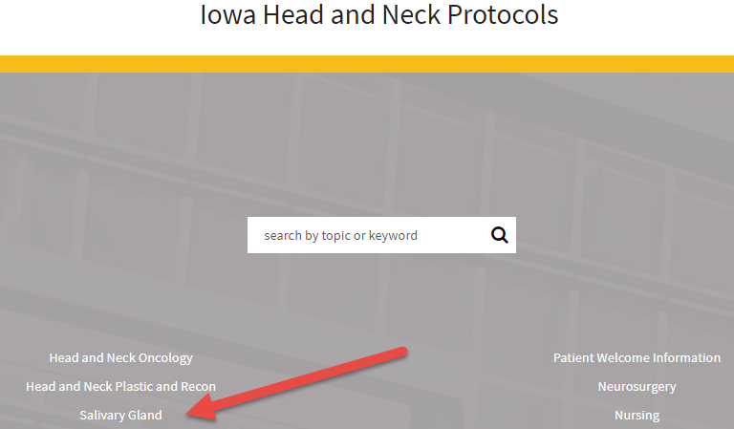
Advanced Sialendoscopy and Minimally Invasive Surgery
May 5 9:00-9:45
Ultrasound Assisted Surgical Techniques
Henry Hoffman MD University of Iowa
1
1
https://medicine.uiowa.edu/iowaprotocols/salivary-ultrasound
Notes:
Figure 1 The 14-5 Mhx probe used with the Toshiba Aplio 500 ultrasound unit performing diagnostic ultrasound beginning with the upper anterior neck

Slide 2
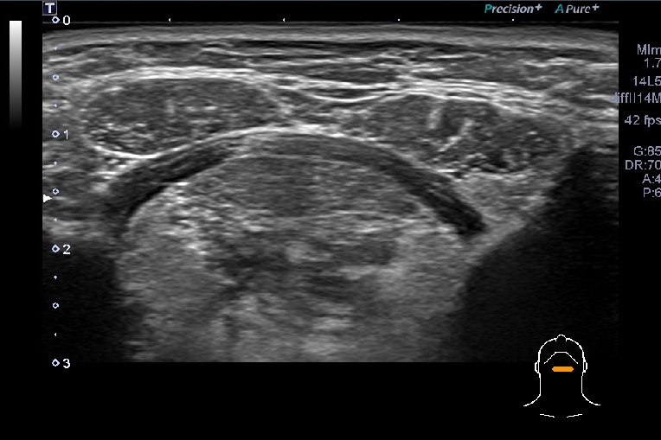
Right
Left
2
subcutaneous tissue
anterior belly
digastric muscle
anterior belly
digastric muscle
mylohyoid muscle
geniohyoid
muscle
genioglossus
muscle
sublingual
gland
sublingual
gland
midline transverse
orientation of 10
megahertz probe
(frequency of 5-14 MHz)
Right
Left
Notes:
Figure 2 Normal submental evaluation of midline upper anterior neck with Toshiba Aplio 500 ultrasound unit with midline transverse orientation employing 10 megahertz (frequency range 5-14 MHz) probe.

Slide 3
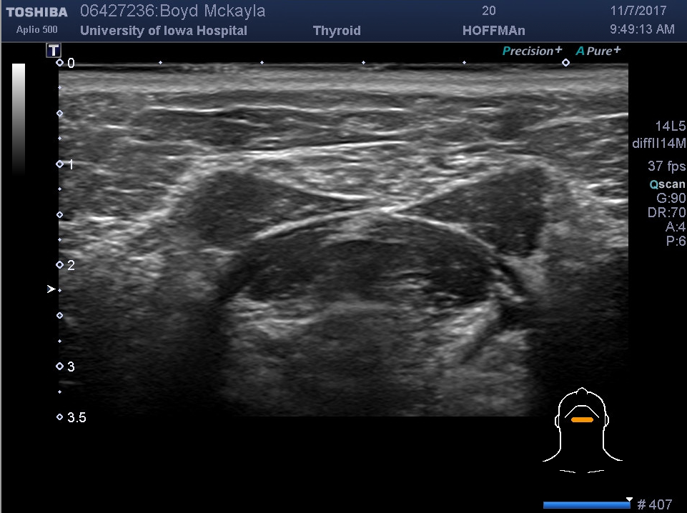
3
A
Orientation of probe
Notes:
Figure 3 Sequence of images of submandibular and parotid glands correlates with the sample operative note below and further refined in figures 4 and 5.
Figure 3A Orientation of the probe in a submental transverse view as identified markerin lower right corner

Slide 4
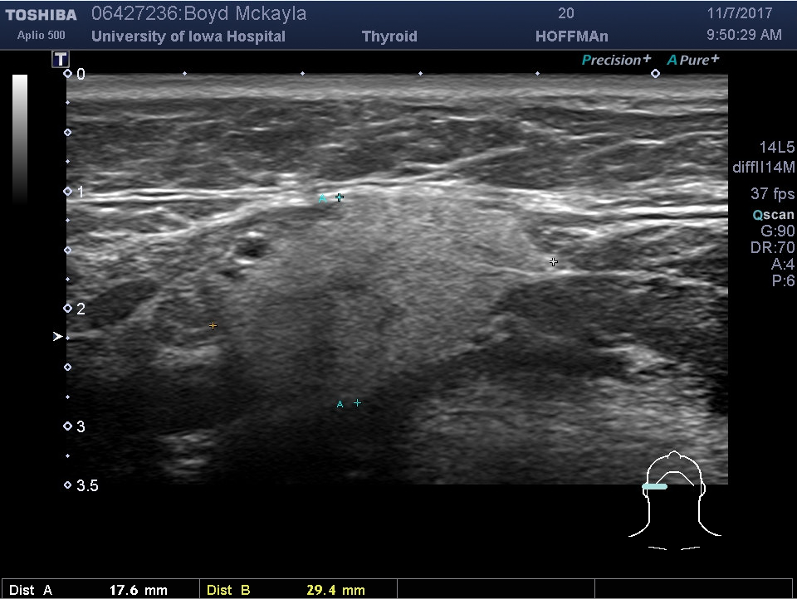
3
B
Skin
A
Depth
in cm
B
B
A
Orientation of probe
Notes:
Figure 3B Transverse image of right submandibular gland encompassed by dotted line measured with width (depth) 17.8 mm (A – A) and length 29.4 mm (B - B)

Slide 5
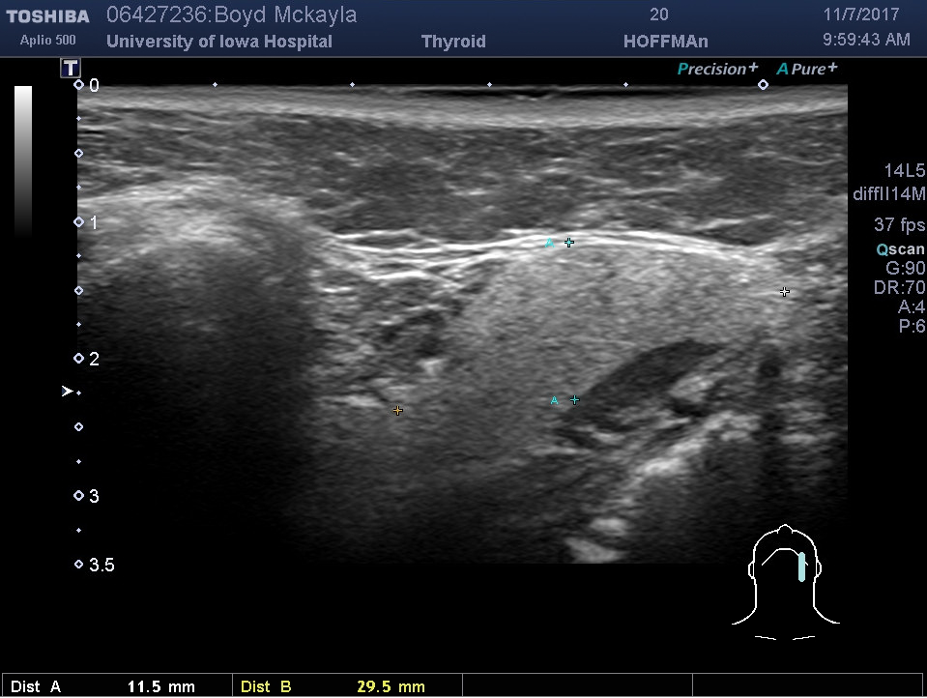
3
C
A
C
M
C
A
Orientation of probe
Notes:
Figure 3C Longitudinal image of right submandibular gland with superior on the left of the image defined by the mandible (M) with the width (depth of the gland B - B) similar to Figure 3B and vertical dimension identified as C - C

Slide 6
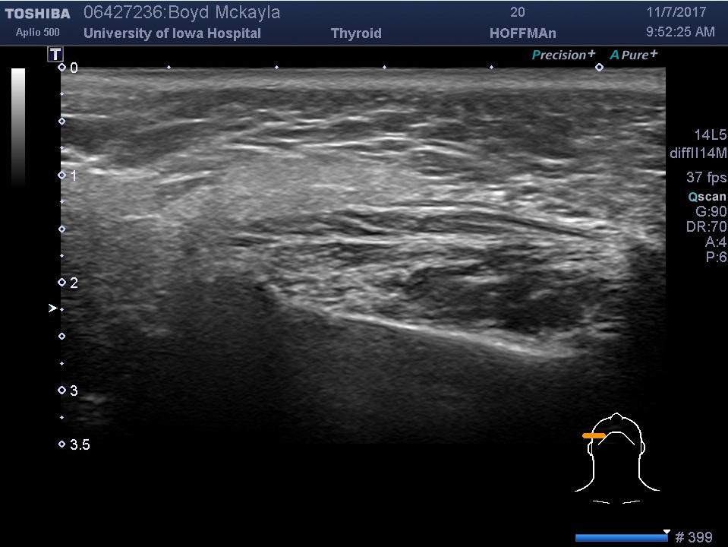
3
D
masseter
Orientation of probe
Notes:
Figure 3D Transverse image of right parotid gland defined by dotted line and oriented with respect to masseter muscle

Slide 7
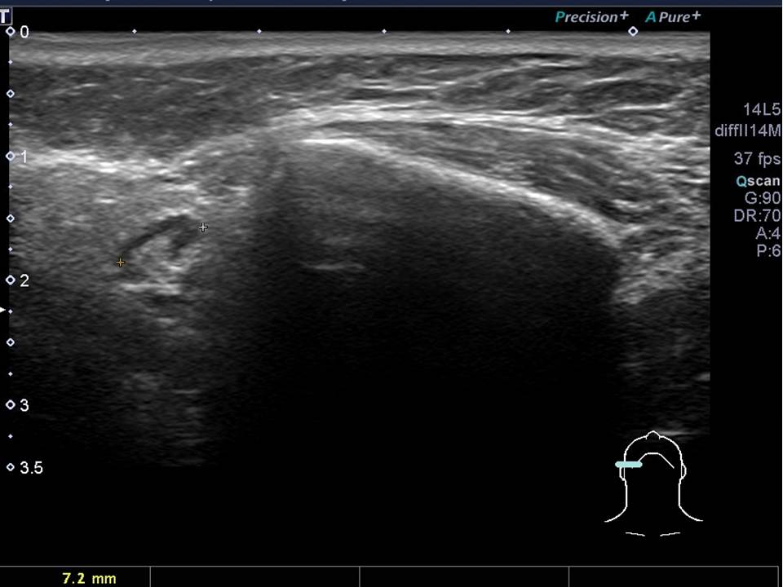
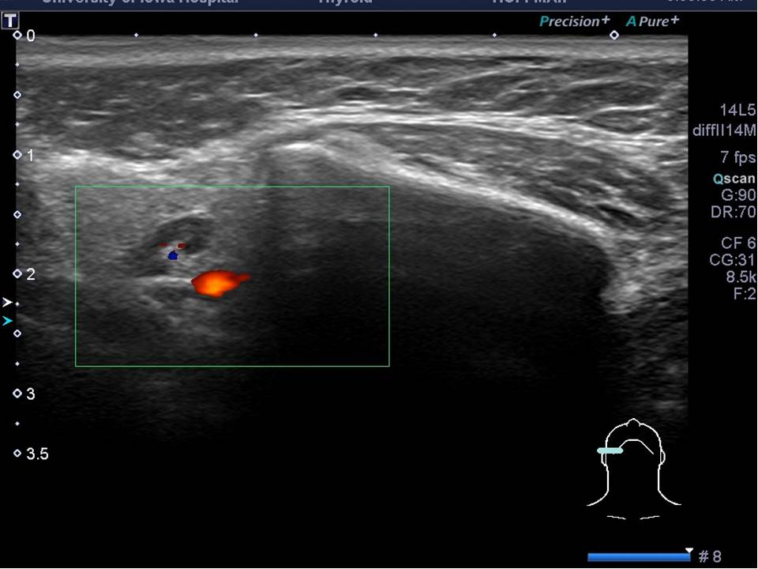
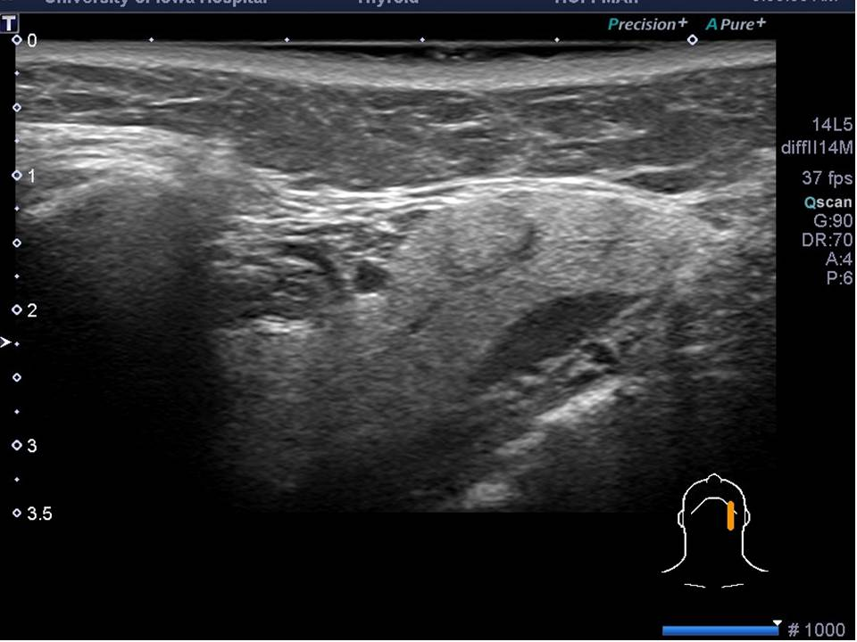
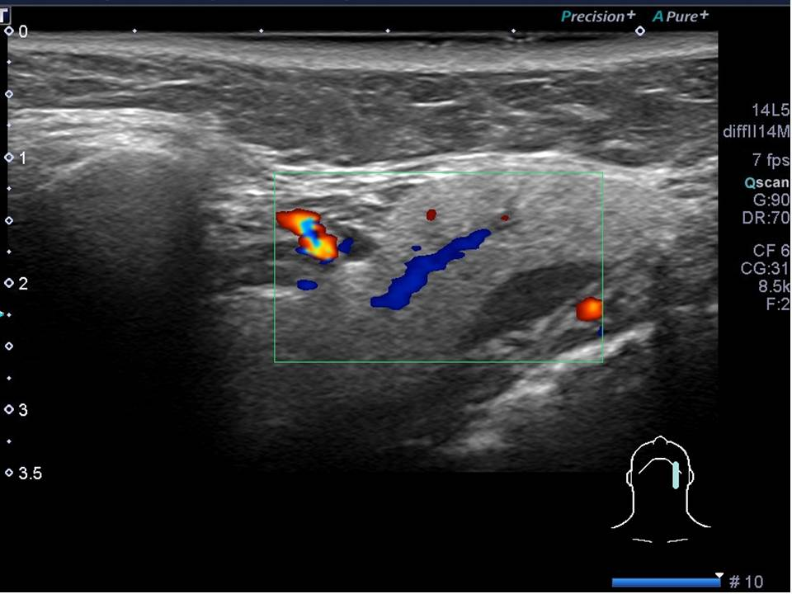
4
A
7.2 mm
lymph node
B
masseter
vascular hilum
shadow of mandible
obscuring imaging of
deep lobe
external carotid
color doppler
Right parotid transverse
Right parotid transverse
C
D
facial a. and branches
superior
superior
superior
Color doppler
Left submandibular - longitudinal
Left submandibular - longitudinal
Notes:
Figure 4 Further sampling of images showing (upper images) use of color Doppler to define a normal lymph node and the external carotid artery in tail of right parotid. Doppler (lower images) also demonstrated to identify branches of the facial artery associated with the left submandibular gland.

Slide 8
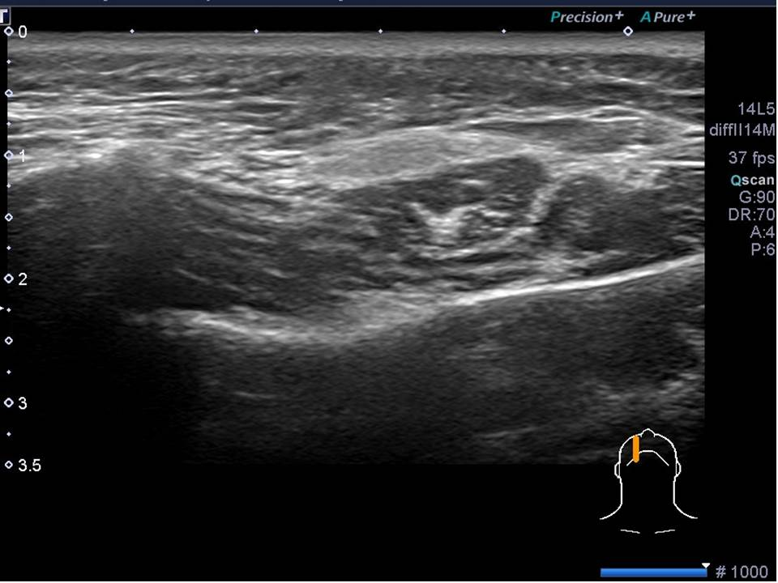
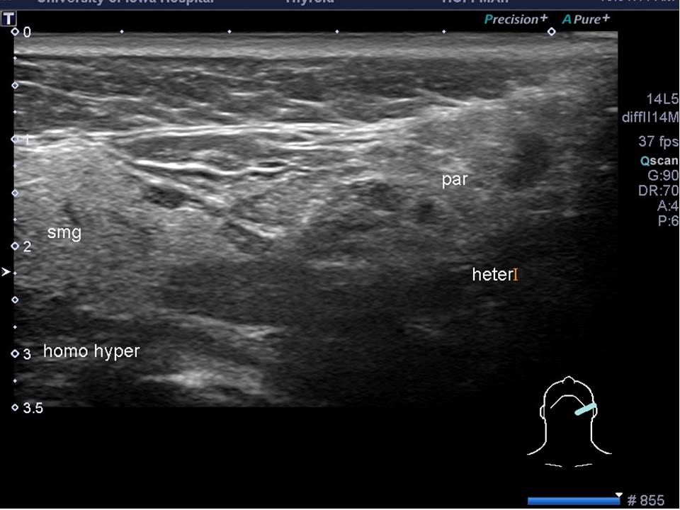
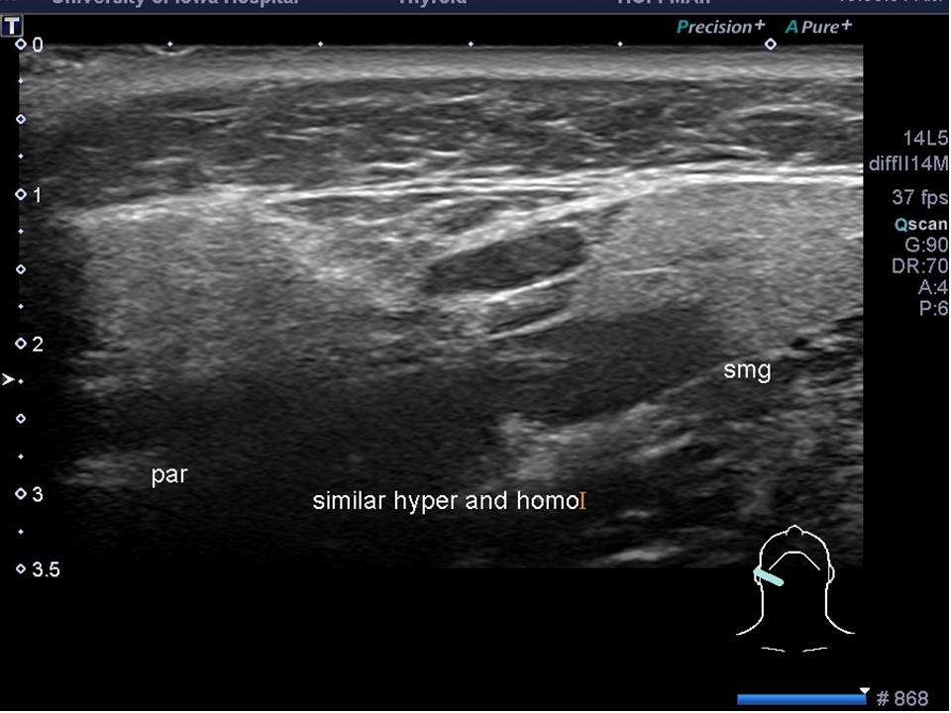
A
5
B
accessory lobe
zygomatic
arch
rotate
to
anatomic
orientation
zygomatic
arch
masseter
accessory
lobe of
parotid
masseter
mandible
right parotid
longitudinal view
C
D
Heterogenity of left parotid compared to right parotid
Oblique view includes smg and parotid
Oblique view includes smg and parotid
Notes:
Figure 5 Standard screen orientation for longitudinal view of right parotid (superior is on left of screen) in the upper images. Side-by-side comparison of echogenicity (lower images) shows a homogeneous hyperechoic left submandibular gland and hypoechoic and heterogeneous left parotid tail.

Slide 9
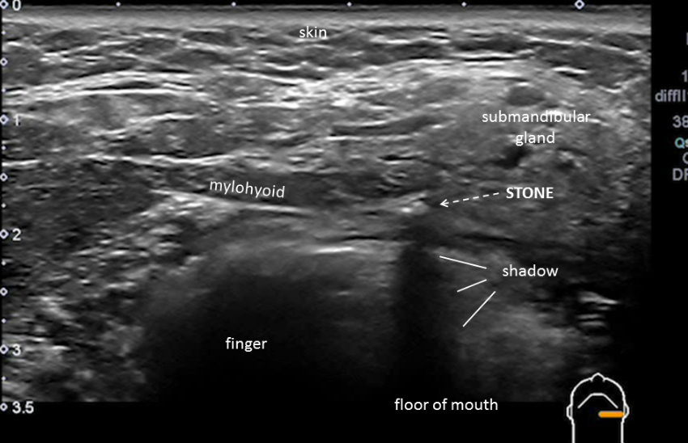
Sonopalpation:
https://medicine.uiowa.edu/iowaprotocols/sonopalpation-ultrasound-submandibular-stone
https://medicine.uiowa.edu/iowaprotocols/salivary-ultrasound-sonopalpation-stone
5a

Slide 10
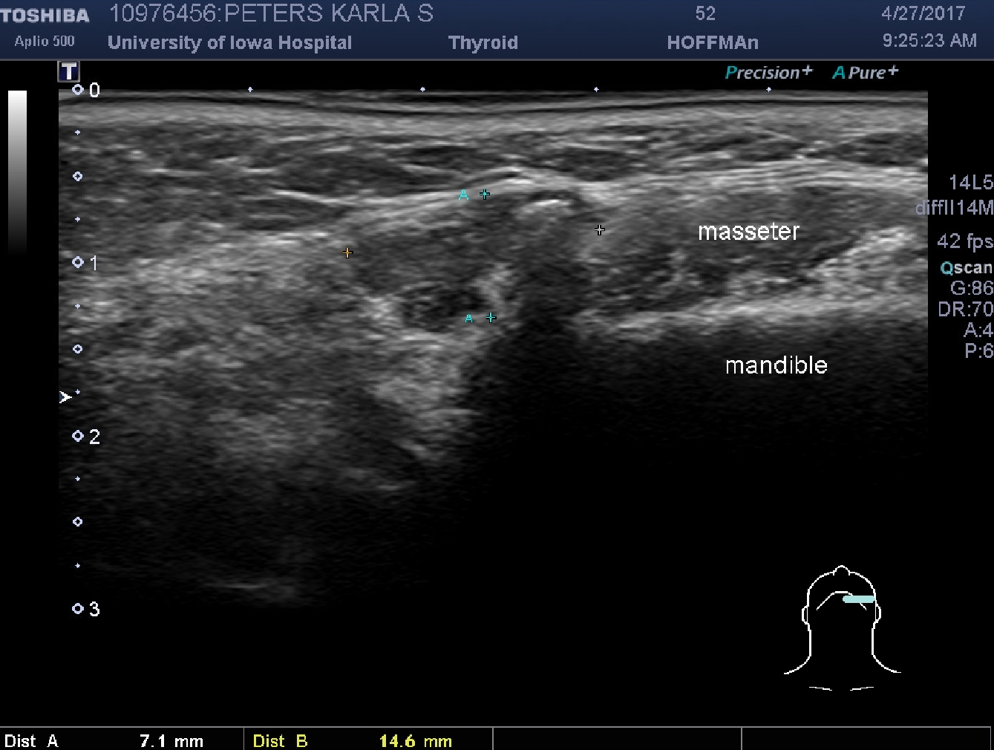
Nn
phlebolith
6
A
shadow
Notes:
Figure 6. Transverse ultrasound images of a heterogeneous hypoechoic mass with internal calcifications located at the anterior aspect of the masseter distinct from normal parotid and confirmed with MRI as a veno-lymphatic malformation with phleboliths.

Slide 11
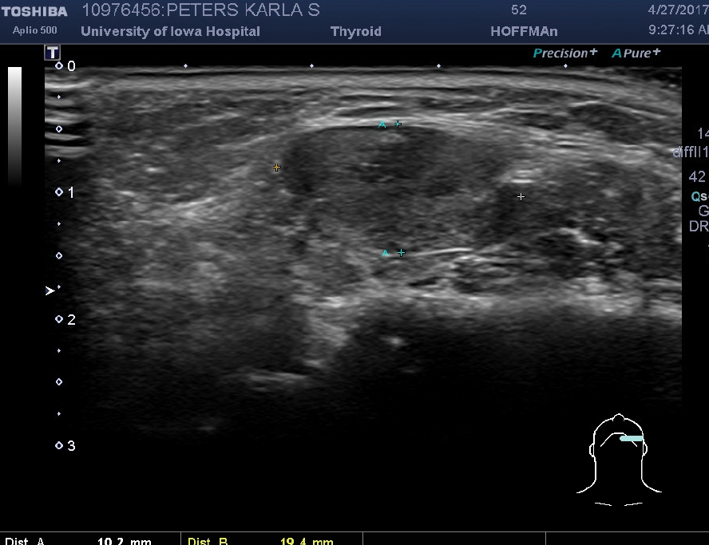
B
6
19.4 x 10.2 mm compressible mass
anterior to masseter
separate from parotid

Slide 12
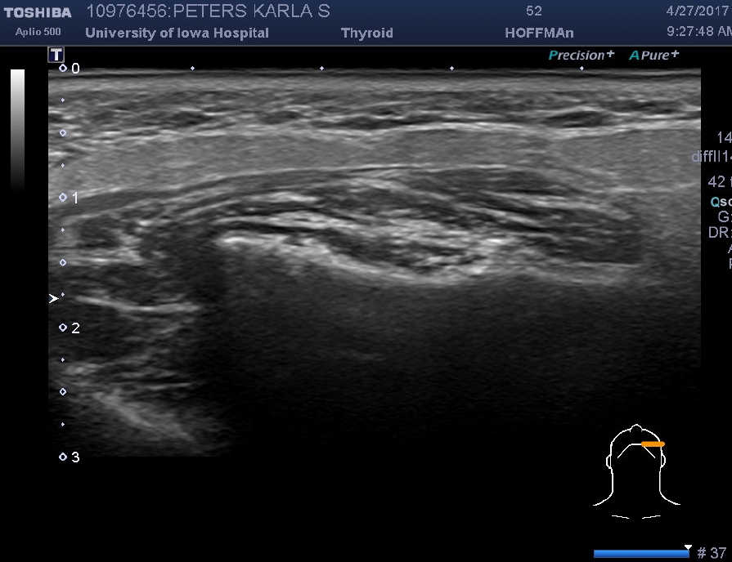
C
6
accessory lobe
masseter
mandible
Notes:
Figure 6. Transverse ultrasound images of a heterogeneous hypoechoic mass with internal calcifications located at the anterior aspect of the masseter distinct from normal parotid and confirmed with MRI as a veno-lymphatic malformation with phleboliths.

Slide 13
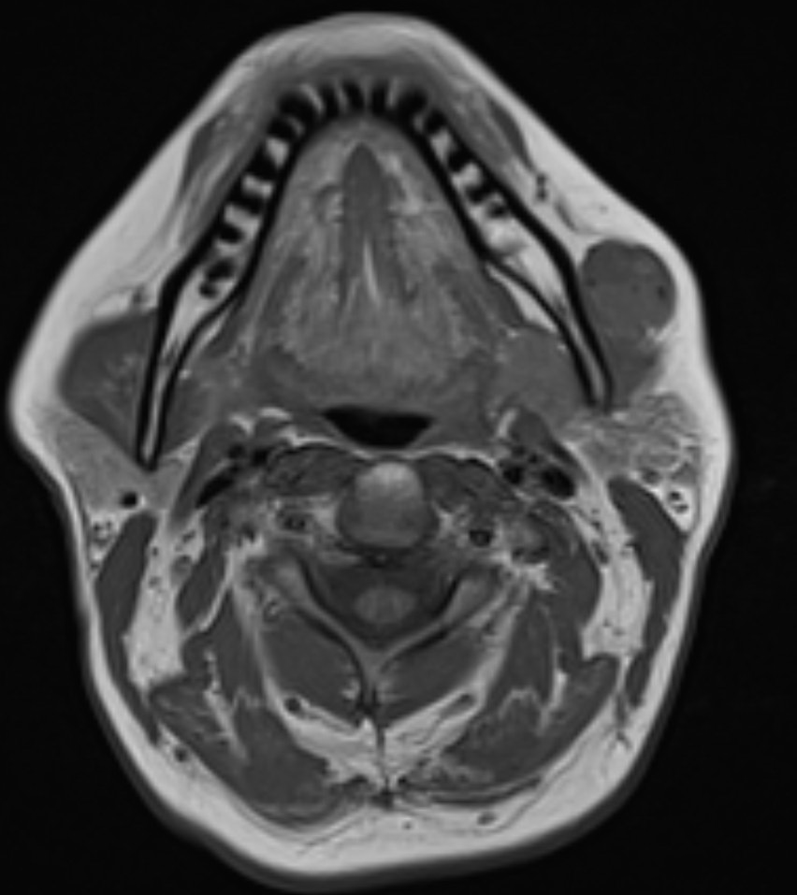
D
6
a
b
c
Notes:
Figure 6. Transverse ultrasound images of a heterogeneous hypoechoic mass with internal calcifications located at the anterior aspect of the masseter distinct from normal parotid and confirmed with MRI as a veno-lymphatic malformation with phleboliths.

Slide 14
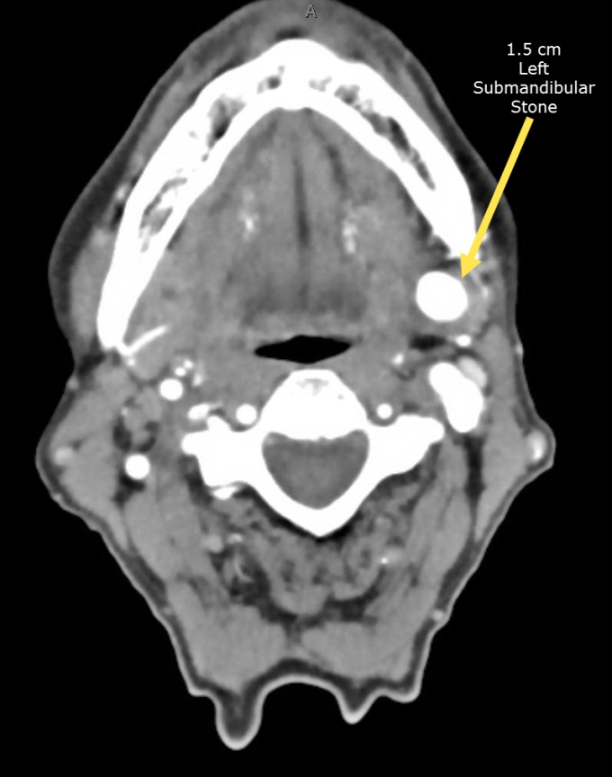
7
A
Notes:
Figure 7 A 1.5 cm stone in the hilum of the left submandibular gland grossly appears as a yellow concretion in the resected gland permitting correlation with preop ultrasound and CT imaging. (with permission from Hoffman HT (ed) Iowa Head and Neck Protocols “Sialolithiasis” < https://medicine.uiowa.edu/iowaprotocols/ultrasound-ct-sialendoscopy-and-gross-appearance-submandbiular-stone> accessed November 1, 2017)

Slide 15
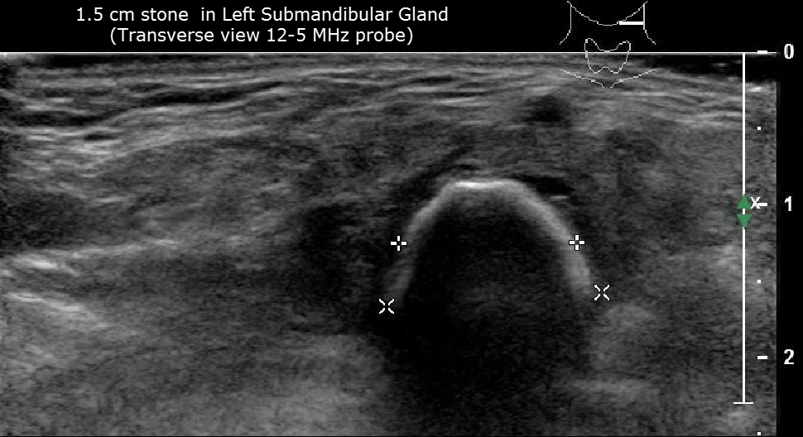
7
B
Notes:
Figure 7 A 1.5 cm stone in the hilum of the left submandibular gland grossly appears as a yellow concretion in the resected gland permitting correlation with preop ultrasound and CT imaging. (with permission from Hoffman HT (ed) Iowa Head and Neck Protocols “Sialolithiasis” < https://medicine.uiowa.edu/iowaprotocols/ultrasound-ct-sialendoscopy-and-gross-appearance-submandbiular-stone> accessed November 1, 2017)

Slide 16
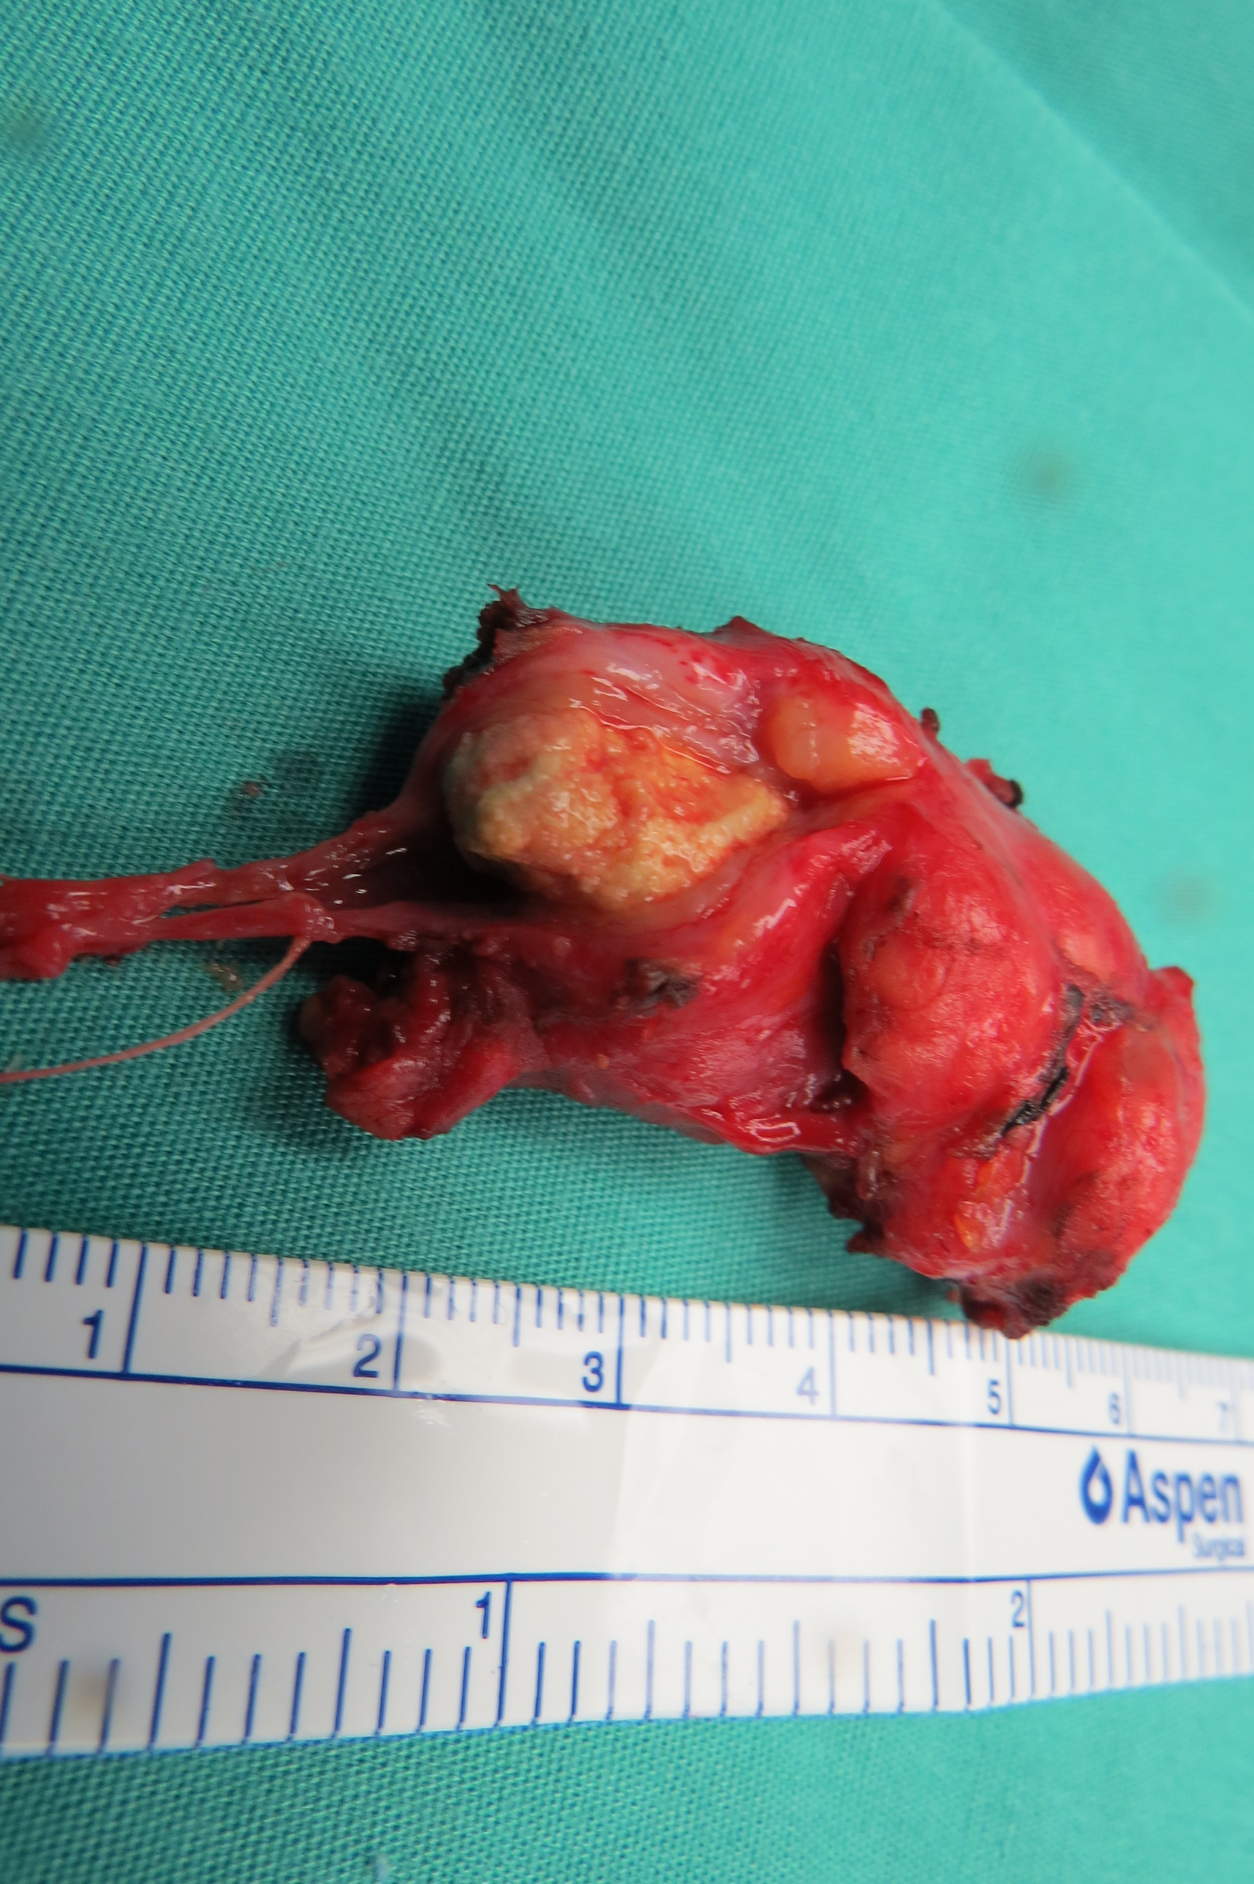
7
C
Notes:
Figure 7 A 1.5 cm stone in the hilum of the left submandibular gland grossly appears as a yellow concretion in the resected gland permitting correlation with preop ultrasound and CT imaging. (with permission from Hoffman HT (ed) Iowa Head and Neck Protocols “Sialolithiasis” < https://medicine.uiowa.edu/iowaprotocols/ultrasound-ct-sialendoscopy-and-gross-appearance-submandbiular-stone> accessed November 1, 2017)

Slide 17
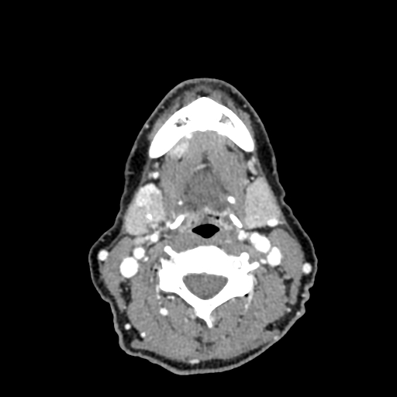
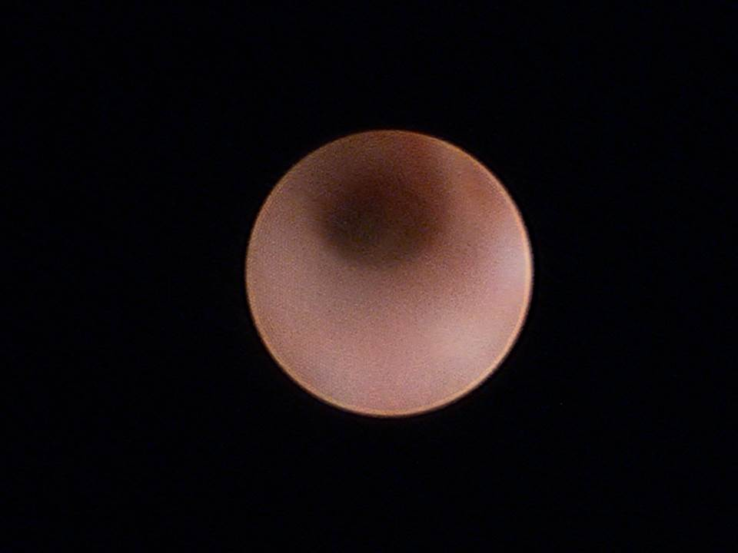
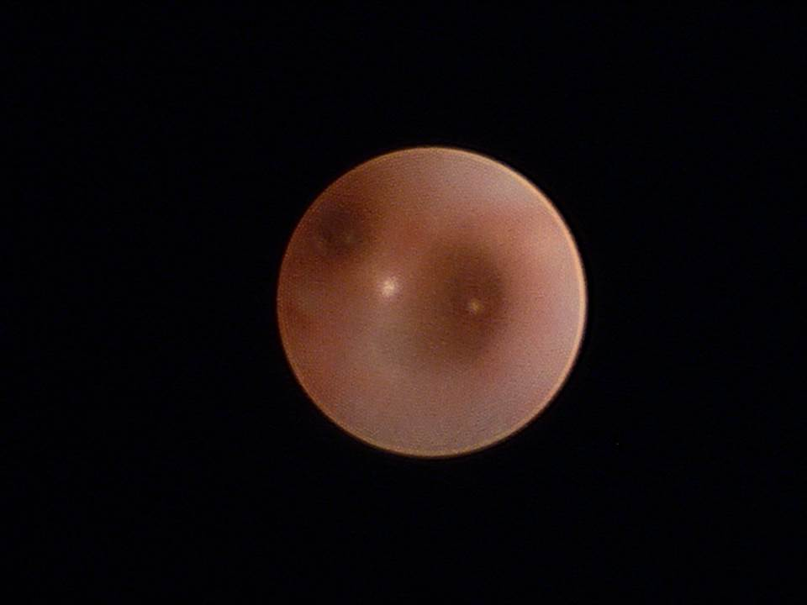
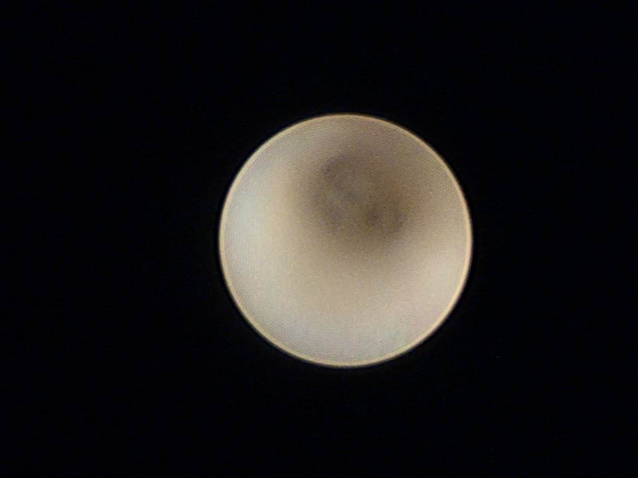
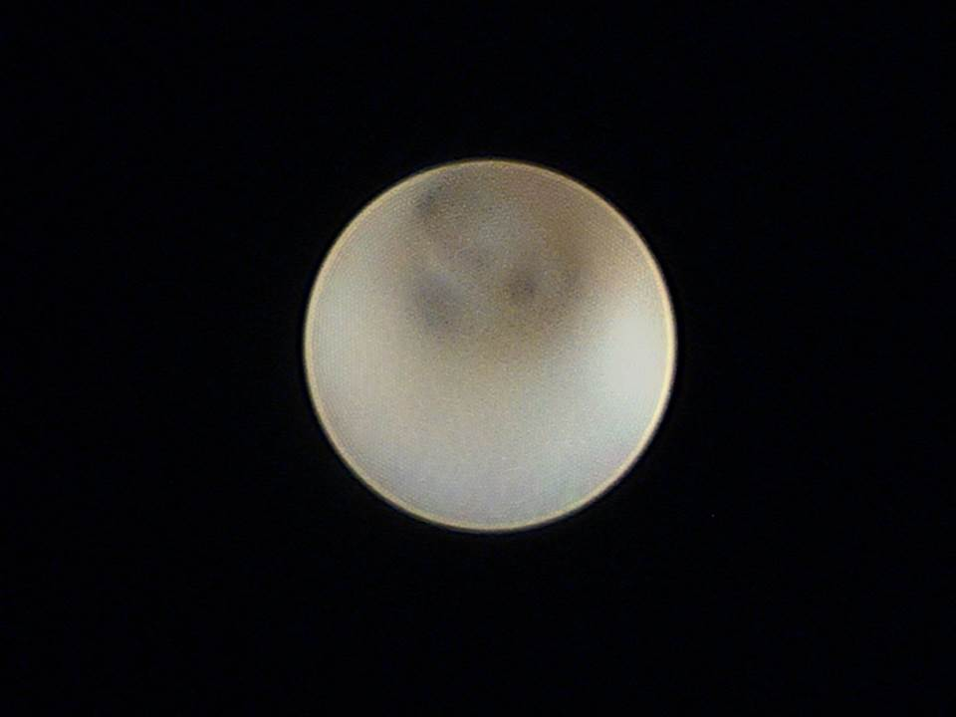
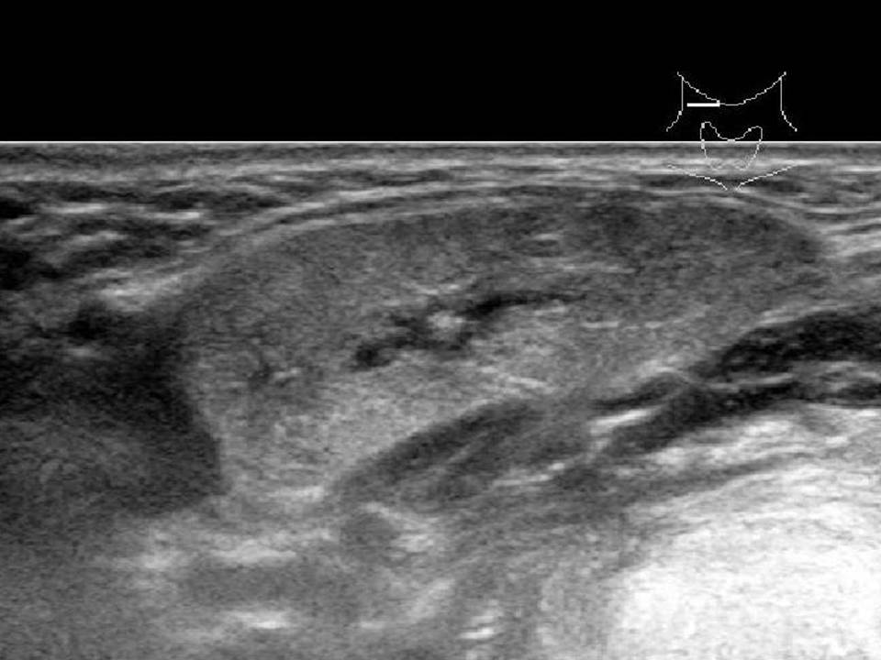
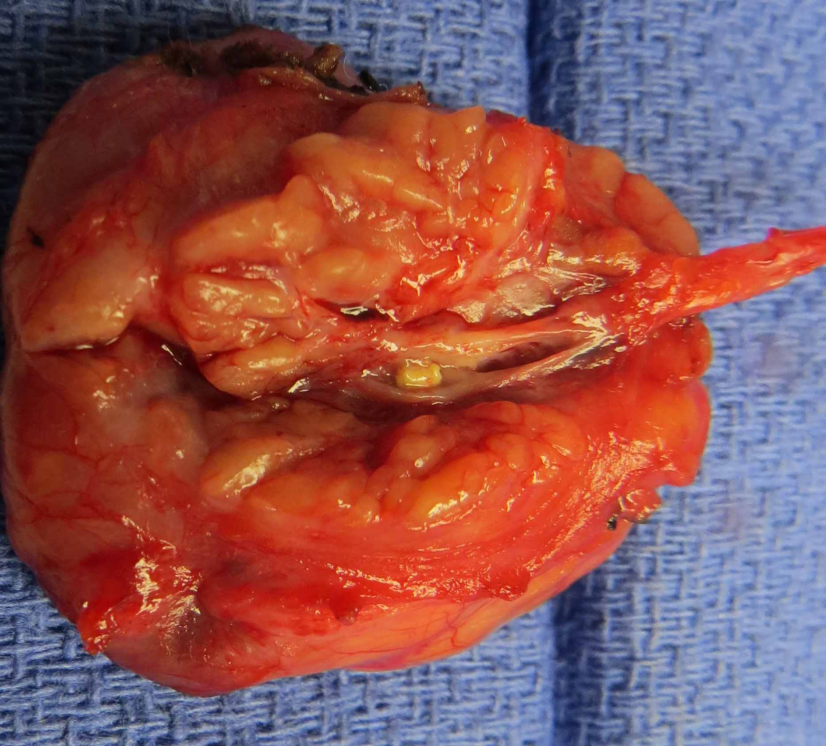
A
sialendoscopy
8
B
2 mm stone
proximal to
stricture of
right
Wharton’s duct
stone
C
D
Notes:
Figure 8 Dilated hilum and proximal duct containing small stone are shown with correlates from CT, ultrasound, sialendoscopy with the resected gland showing a tight stricture preventing endoscopic visualization of the stone. (with permission from Hoffman HT (ed) Iowa Head and Neck Protocols “Sialolithiasis” < https://medicine.uiowa.edu/iowaprotocols/salivary-stone-imaging-correlates> accessed November 1, 2017)

Slide 18
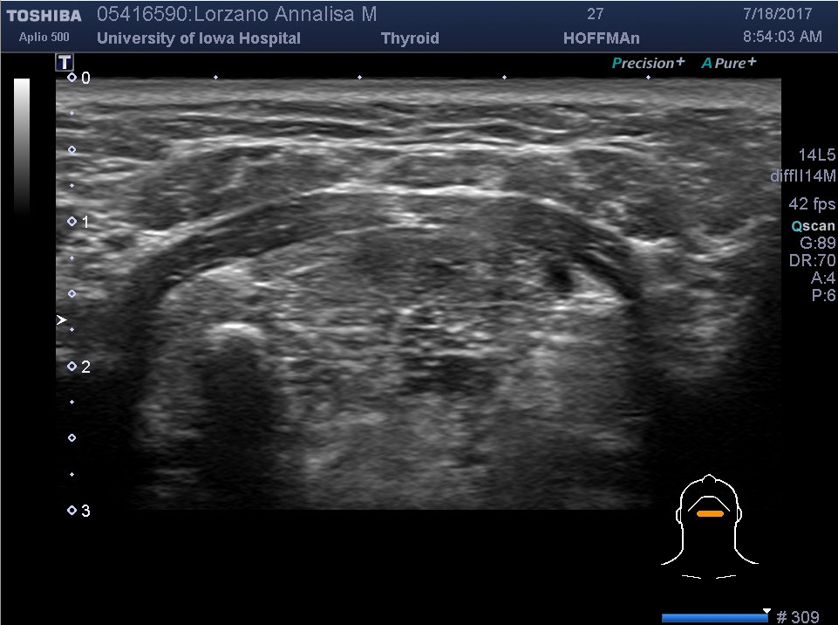
A
9
anterior belly
digastric
anterior belly
digastric
mylohyoid
geniohyoid
sublingual
gland
sublingual
gland
R submandibular duct stone
with
shadow
Midline transverse
orientation of 14
Megahertz probe
Notes:
Figure 9a Midline transverse view of the upper neck identifies a middle third right submandibular stone

Slide 19
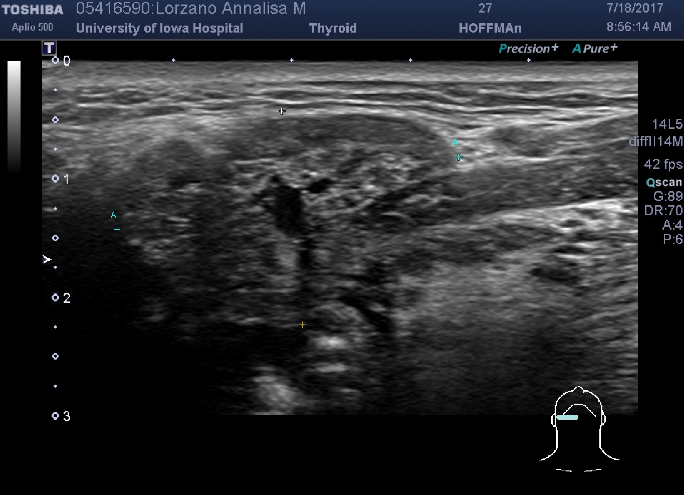
B
SKIN
9
SMG with
dilated ductal system
Mylohyoid muscle
Floor of mouth
Transverse orientation
of 14 Megahertz probe
overlying right SMG
Depth = A ----- A
Length = + ----- +
29.5 x 18.1 mm
Notes:
Figure 9b. The 1 cm stone created a dilated ductal system (including the hilum) of a 29.5 x 18.1 mm hypoechoic heterogeneous right submandibular gland.

Slide 20
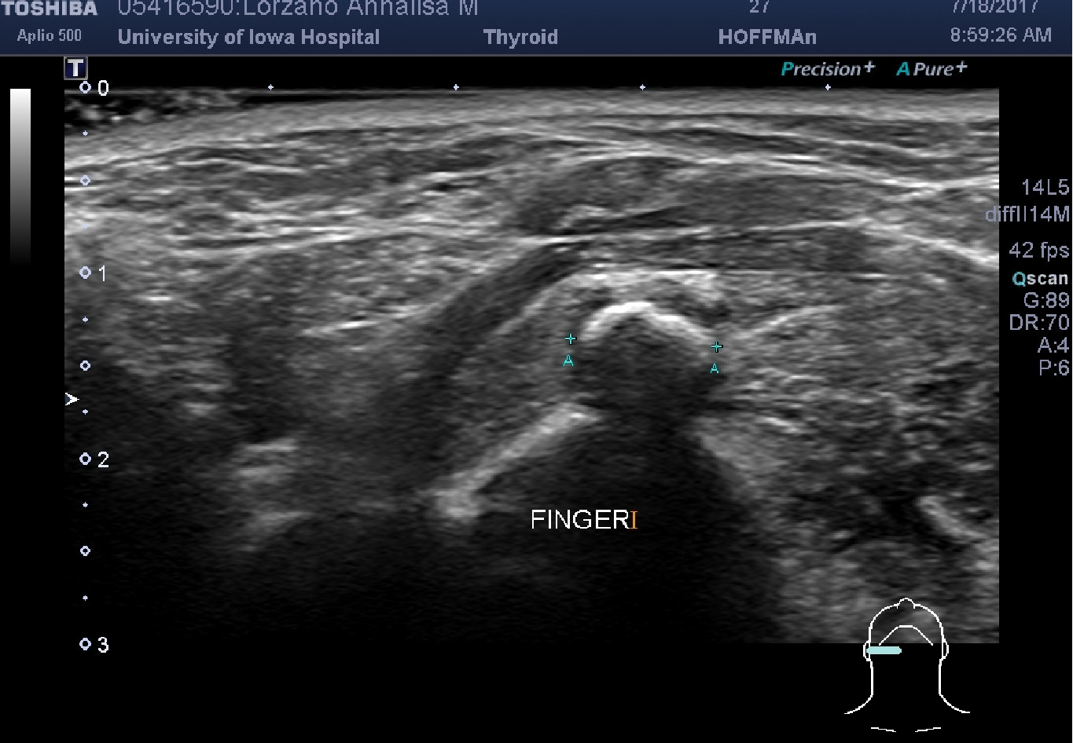
C
9
mylohyoid
Submandibular
gland
stone width = 7.9 mm
A+ --- A+
Notes:
Figure 9c Sonopalpation with placement of the index finger intraorally permits added perspective and definition of the 1 cm stone which, in this orientation, was measured at 7.9 mm.

Slide 21
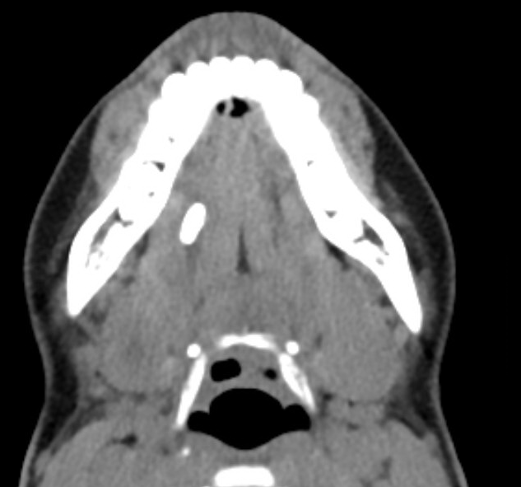
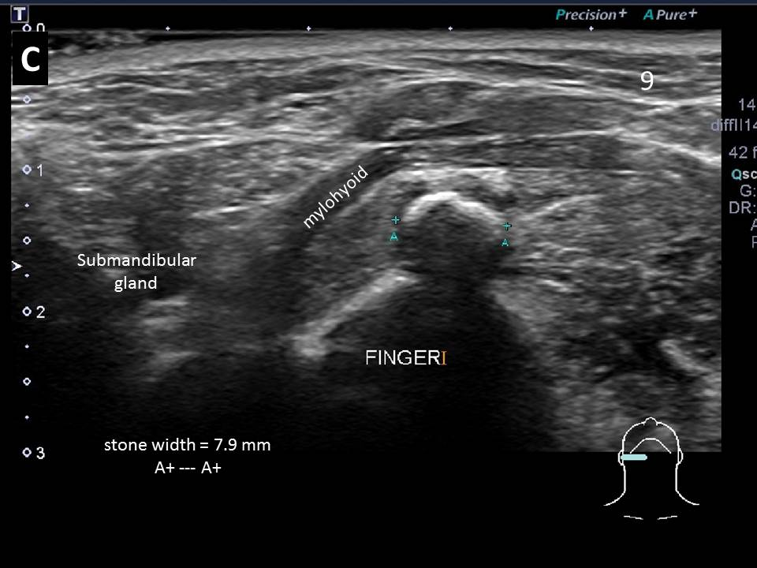
Sialolithiasis Definition: | from Goncalves et al "Sonography in Diagnosis of Sialolithiasis" | J Ultrasound Med 2017;36:2227-2235
"Hyperechoic reflexes with distal signal loss along the course of the duct" | Submandibular sonographic landmarks | Partoid sonographic landmarks
Intraparenchymal stone | proximally located in parenchyma | proximally located in parenchyma
Proximal/hilar stone | 1 cm proximal to 1 cm distal to the edge of the mylohyoid muscle | 1 cm proximal to the posterior edge of masseter to middle of masseter muscle
Middle third | 1 cm distal to the edge of the mylohyoid muscle to the sublingual gland | middle of masseter muscle to to anterior edge of masseter
Distal duct including papillary region | from the main mass of the sublingual gland to the papilla | anterior edge of masseter muscle to papilla
Classification of stone location (Goncalves et al 2017)

Slide 22
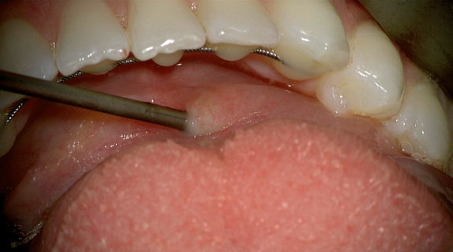
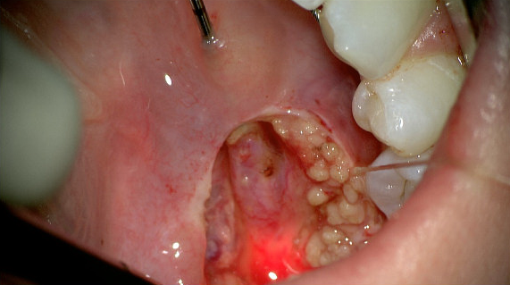
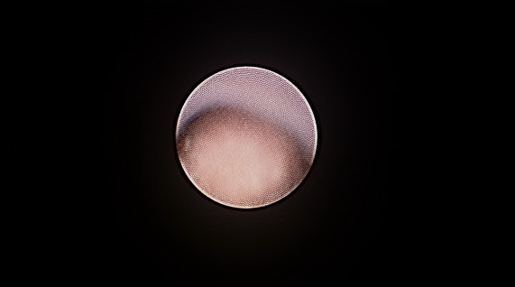
D1
9
D2
D4
D3
Notes:
Figure 9d The 1 cm stone identified on axial CT imaging coupled with endoscopic aided open approach through the floor of mouth to the duct

Slide 23
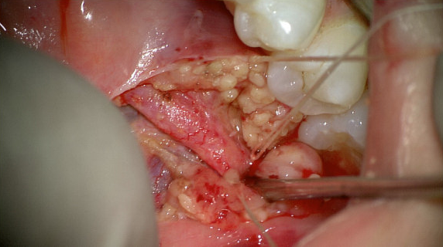
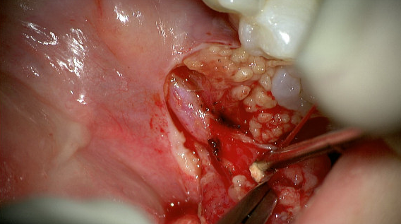
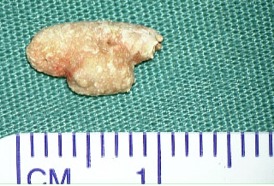
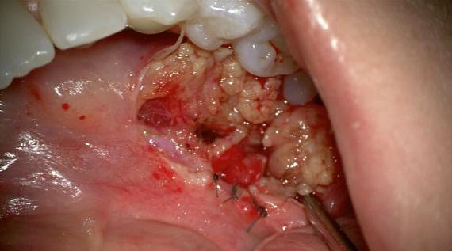
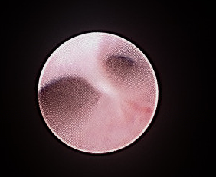
E1
9
E2
E3
E4
Notes:
Figure 9e Open approach to stone removal is demonstrated with ductoplasty and final view of the gland hilum with sialendoscopy (with permission from Hoffman HT (ed) Iowa Head and Neck Protocols “Sialolithiasis” < https://medicine.uiowa.edu/iowaprotocols/salivary-ultrasound-sonopalpation-stone-favorable-transoral-removal> accessed November 1, 2017)

Slide 24
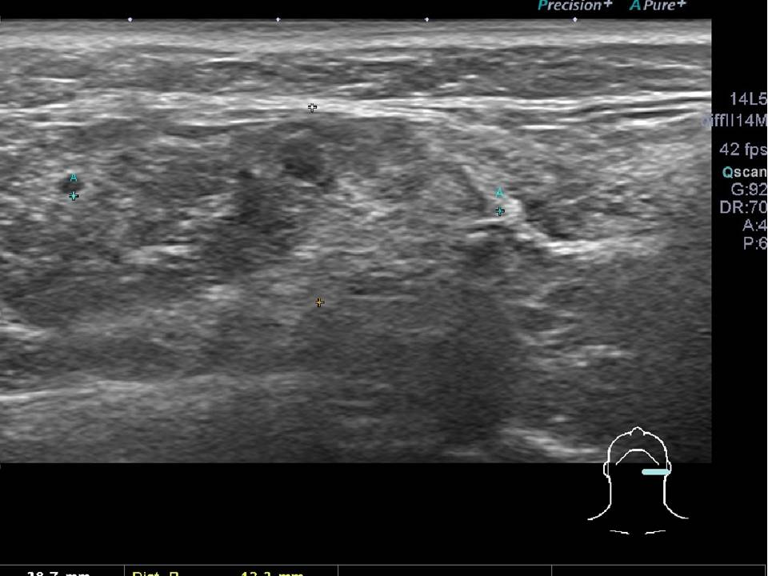
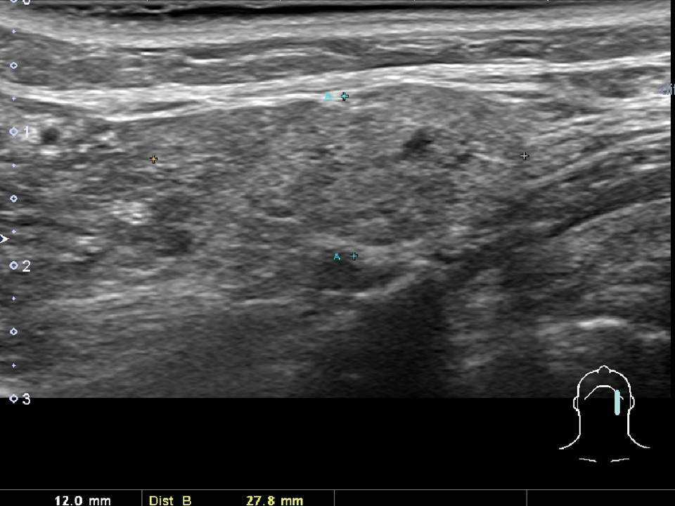
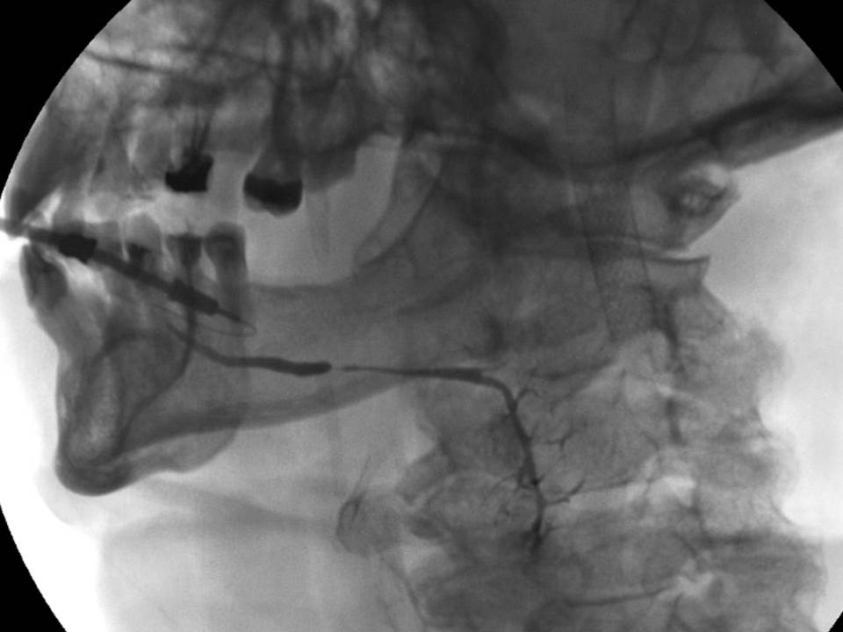
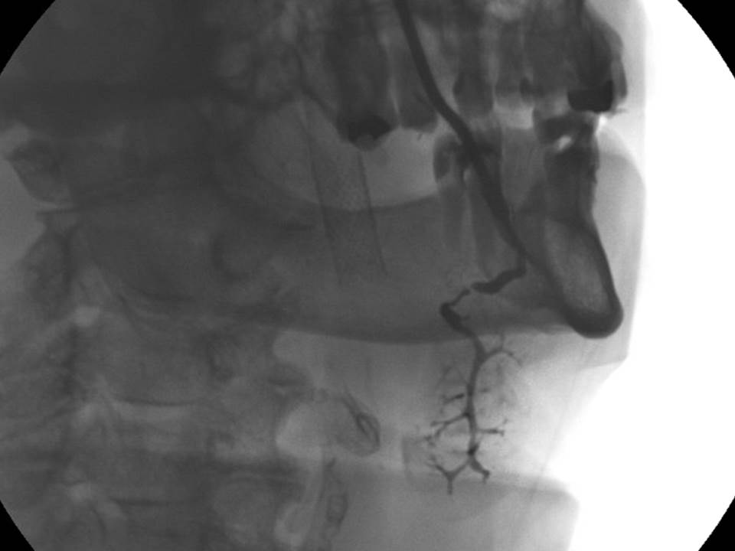
A
Heterogeneity of hypo-intense
signal of abnormal left submandibular gland
10
B
transversee
longitudinal
C
D
Submandibular duct stricture
demonstrated on sialogram
Notes:
Figure 10 Ultrasound demonstrates heterogeneity in signal in abnormal left submandibular gland (upper images) that is not sufficiently sensitive to detect the subtle ductal narrowing identified on sialography (lower images)

Slide 25
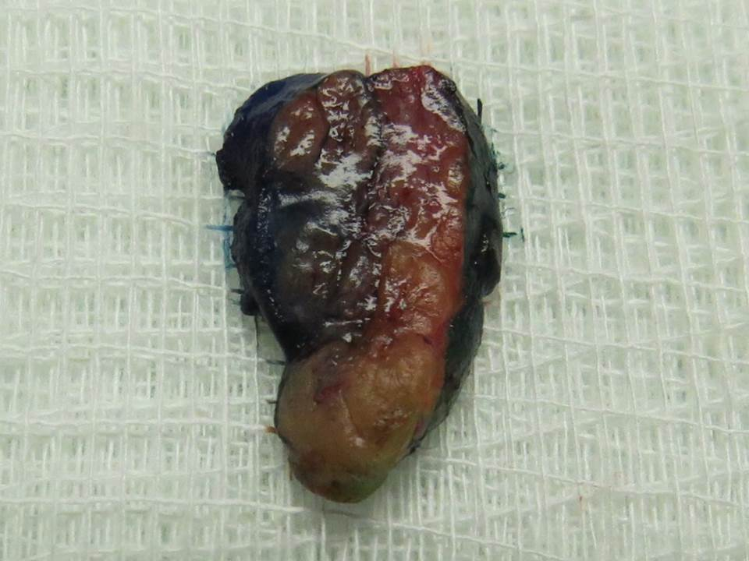
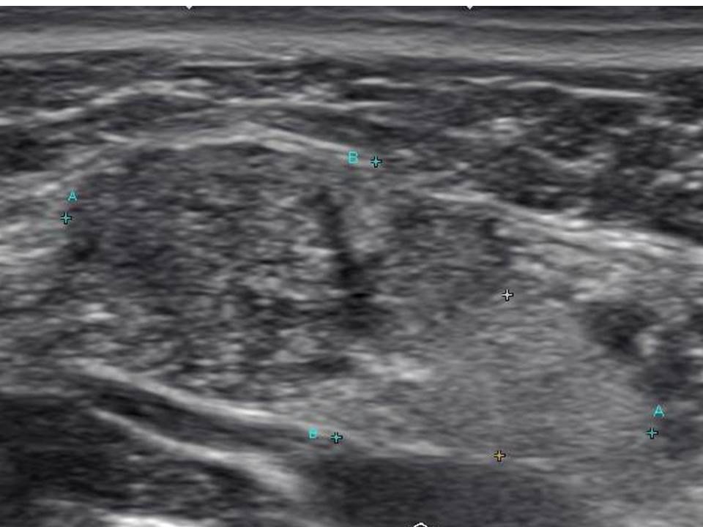
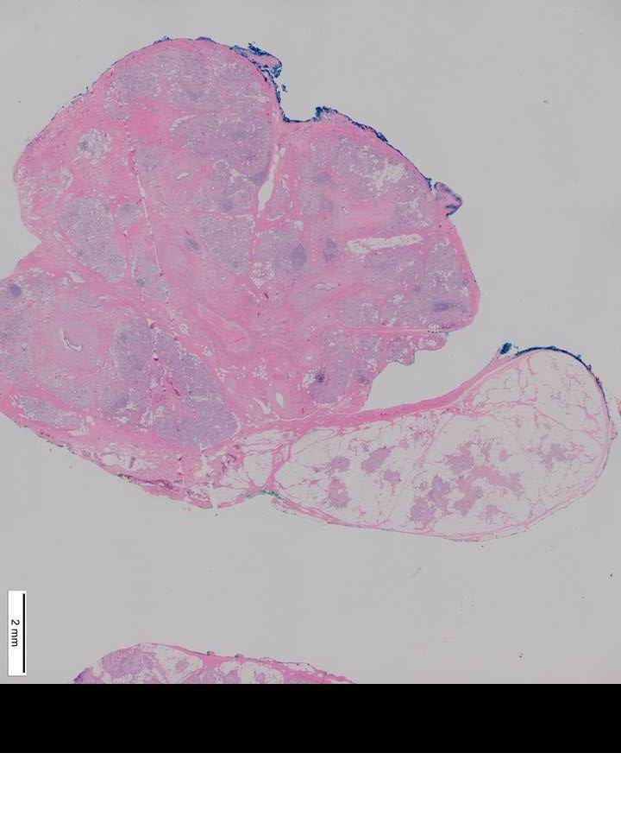
A
Chronic sialadenititis
11
B
Normal submandibular gland
Chronic Sialadenitis
C
Normal SMG
Notes:
Figure 11 A patient with chronic sialadenitis underwent gland resection permitting correlation between ultrasound findings and pathologic findings.

Slide 26
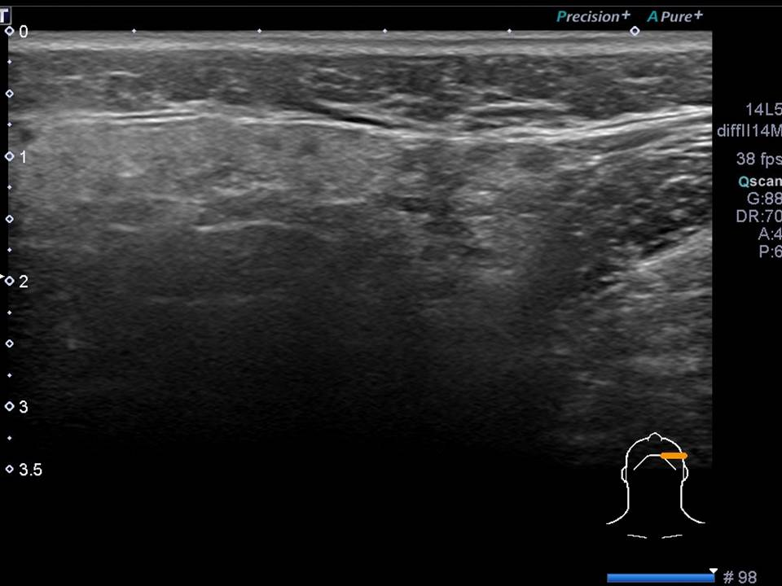
A
B
12
Multiple hypoechoic
regions on transverse
U/S of left parotid
CT - intra-parenchyma calcifications
C
Sialogram - lateral
D
Sialogram A-P
Notes:
Figure 12 A patient with Sjogrens syndrome was evaluated with ultrasound, CT and sialography permitting correlation of images demonstrating parotid abnormalities.

Slide 27
A1
A2
13
A3
Notes:
Figure 13a Intraoperative Ultrasound guided placement of a 16 gauge Angiocath permitted access to the parotid duct with the sialendoscope placed through the angiocatheter with MR defining the dilation proximal to stenosis.

Slide 28
B1
B2
13
Notes:
Figure 13b Percutaneous access of the duct permitted transillumination to the oral cavity and a ductoplasty to re-establish drainage.

Slide 29
A
Bilateral parotid
swelling and pain for 7 years
occurring with meals
14
CT imaging – radiologist interpretation
“unremarkable bilateral parotid glands”
Comment: “thick (3 mm) slices
limiting sensitivity of exam”
Ultrasound: slight heterogeneity (coarse features) to hyperechoic parotid gland

Slide 30
B
14
R
L
Bilateral Sialograms
Multifocal high grade strictures
with proximal dilation
R
L

Slide 31
C1
C
14
C2
C3

Slide 32
D
Intraoperative U/S imaging during sialendoscopy
14
Notes:
Figure 14b Sequence of images demonstrating transillumination of the duct system with initial view of the sialendoscope with ultrasound imaging in preparation for placement of the sialoballoon.

Slide 33
E
14
subcutaneous tissue
sialendoscope
parotid
gland
masseter muscle
mandible

Slide 34
F
14
Sialoballoon
Notes:
Figure 14 a The salivary duct balloon catheter (COOK Medical Inc) with pressure insufflator.

Slide 35
G
14
Inflation Device

Slide 36
G
Inflation Device

Slide 37
H
14

Slide 38
I
14
subcutaneous tissue
sialoballoon
parotid
gland
masseter muscle

Slide 39
J
J1
14
sialoballoon
Imaging with
0.8 mm sialendoscope
Balloon in duct
J2
J3
Pre-dilation
Post-dilation
Notes:
Figure 14c Sequence of images demonstrating the balloon at Stensens duct orifice and then advanced with ultrasound guidance with pre- and post- dilation endoscopic images of the duct stricture

Slide 40
A
chronic parotitis with atrophy of the left parotid gland and a single sialolith.
June CT
15
Notes:
Figure 15 Fluoroscopy with conventional sialography was supplemented in this case by placement of a sialoballoon to address a parotid duct stricture with subsequent ultrasound imaging shortly afterwards still identifying a stone.

Slide 41
B
15
July Sialogram
Stricture
Stone

Slide 42
C
15
dilated duct
parotid
stone
with
shadow
October
ultrasound of left
parotid

Slide 43
D
15
January
balloon dilation of stricture
with sialogram (under fluroscopy)
radio-opaque markers
mark ends of
2 cm long balloon

Slide 44
E
15
January
balloon dilation of stricture
with sialogram (under fluroscopy)
salivary balloon
inflated (3 separate insufflations
to 7-8 atmospheres 15-30 seconds)

Slide 45
January
Ultrasound immediately after
dilation
15
F
Stensen’s Duct
Parotid
gland
distal
Duct
1.6 mm
stone
2.4 mm
proximal
duct
3.3 mm
Oral Cavity
Mandible

Slide 46
A
16
Notes:
Figure 16a An assistant is needed to assist in the insufflation of saline into the sialoballoon positioned with ultrasound guidance into the left parotid duct.

Slide 47
B
Parotid ultrasound
3 weeks after
after fluoroscopic dilation
16
parotid
masseter
intra-oral
0.014 inch
guidewire placed
beyond stricture
Notes:
Figure 16b Ultrasound images of the sialoballoon within the left parotid duct.

Slide 48
C
16

Slide 49
D
Parotid ultrasound
3 weeks after
after fluoroscopic dilation
16
parotid
masseter
intra-oral
3.0 mm sialoballoon
inflated to 8 atmospheres = 3 mm
(+ --- + = 3 mm)

Slide 50
A
17
Parotid U/S guided botox injection
20 units (0.8 cc)
25 gauge needle
B
Notes:
Figure 17 Ultrasound guided Botox injection to the left parotid gland with orientation of probe along the long axis.

Slide 52
18
subcutaneous tissue
mylohyoid
submandibular
gland
Wharton’s duct enlarged (1.7 mm)
after ingesting sour candy
A + -- +A = 1.7 mm
Notes:
Figure 18 Ultrasound imaging demonstrates a normal right submandibular duct dilated by stimulation of salivary flow with ingestion of sour candy.

Slide 53
58 yo man
recurrent right parotid swelling -
10-12 years ago onset
massage produce foul tasting thick mucus
2 courses of antibiotics; one trip to ER
dental artifact compromises CT
thick beard compromises U/S
after jolly rancher

Slide 54
Diagnostic sialogram – identifies stricture
3.0 mm Cook sialoballoon used to dilate
under fluoroscopy expanding to 2.9 mm
F/U by phone 3 months later: much improved

Slide 55
Sialoballoon in place with metal markers
placed across stenosis

Slide 56
Infusion of Isovue 370
to dilate balloon

Slide 58
Dilated segment
identified on withdrawl
of balloon

Slide 59
Minimal retention of contrast
after lemon ingestion following
dilation

