Slide 1
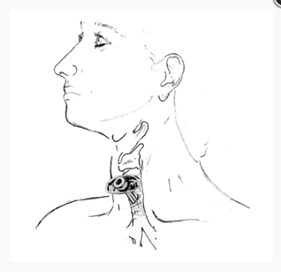
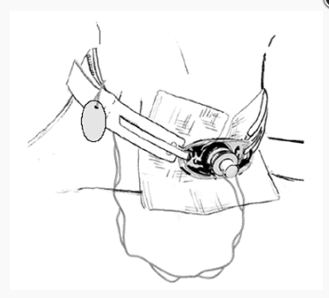
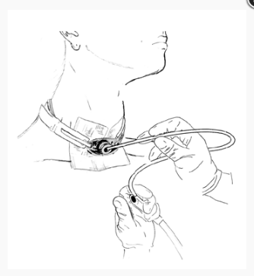
ABEA
Panel II: Trach Lore: Options, Management and Modifications of Airway Prosthesis
H Hoffman slides
Moderator: Paul C Bryson
Panelists: James Daniero Alexander Gelbard Harry Hoffman Christopher Wooten
Thursday April 19, 2018
3:55 pm to 4:40 pm
Maryland B Room
HEADQUARTERS HOTEL
Gaylord National Resort & Convention Center 201 Waterfront Street
National Harbor, MD 20745
301-965-4000

Slide 2
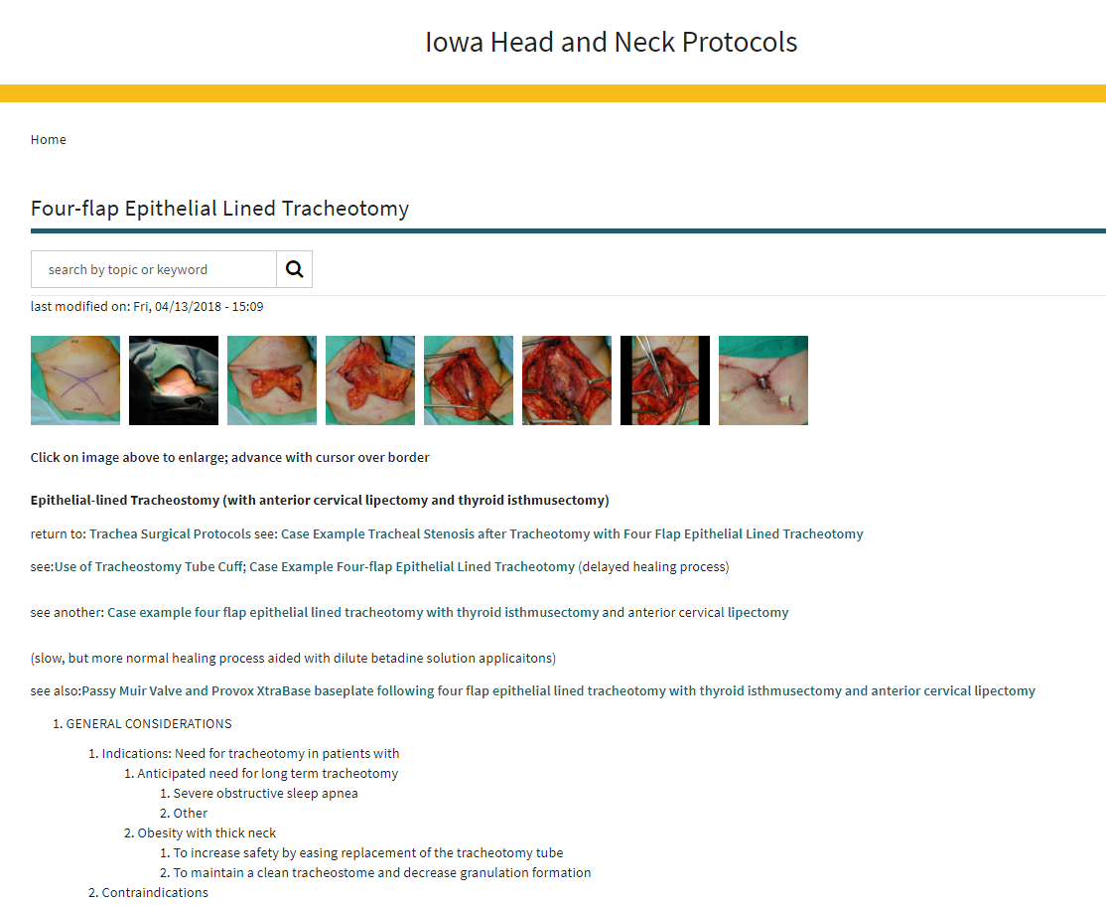
Concept: Don’t use an long trach tube if avoidable
Adapt the anatomy to permit use of a shorter tube

Slide 3
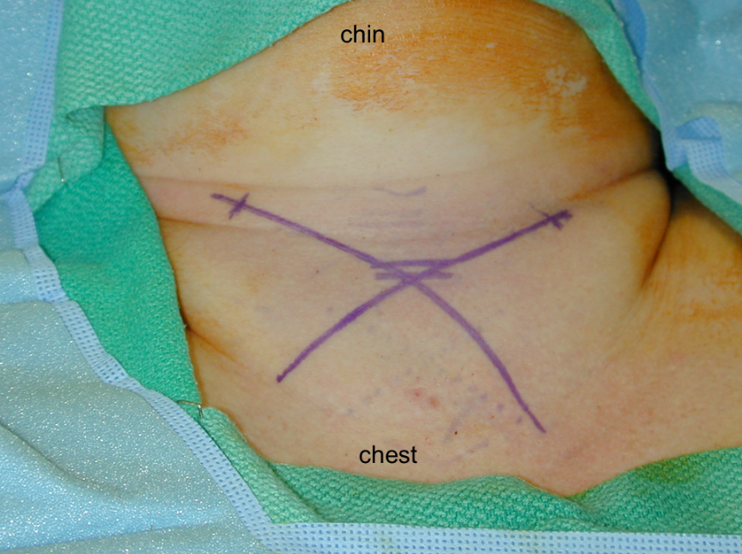
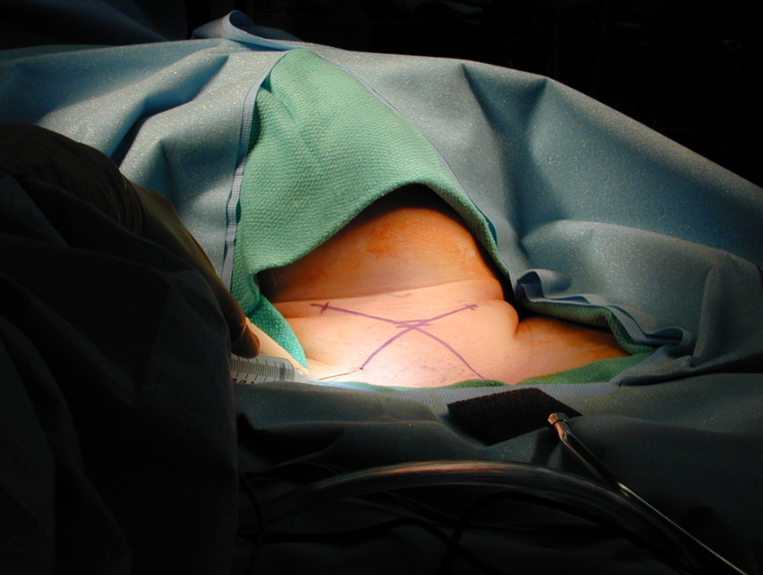
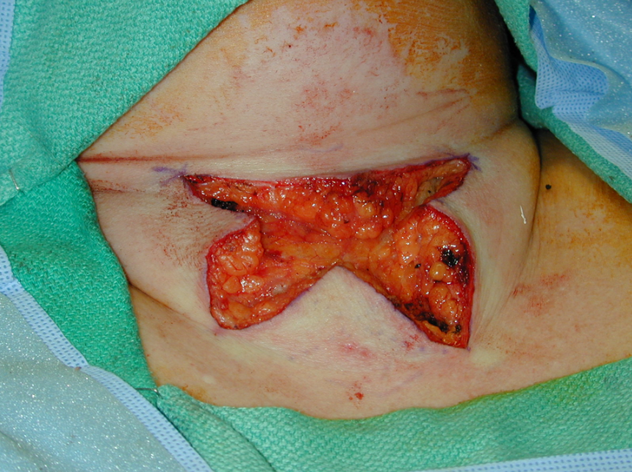
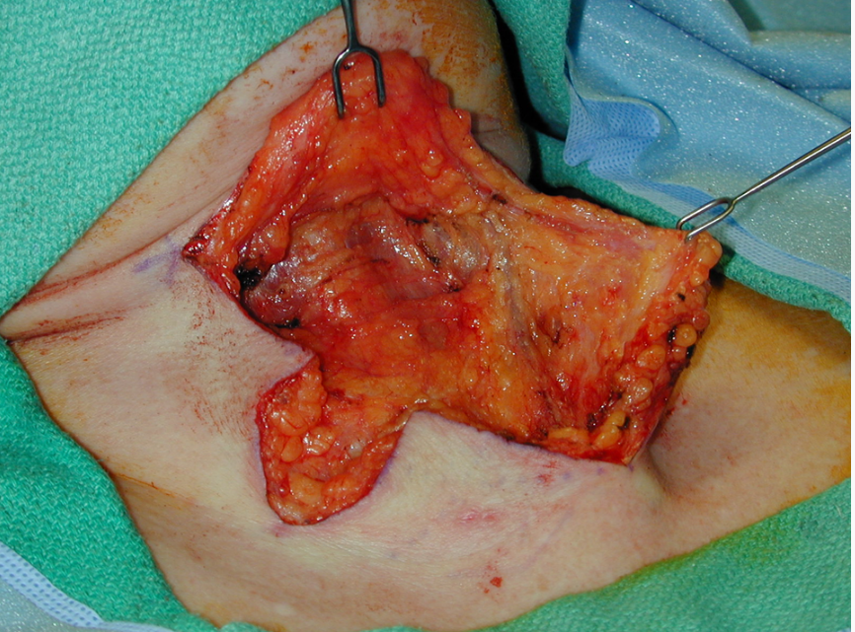

Slide 4
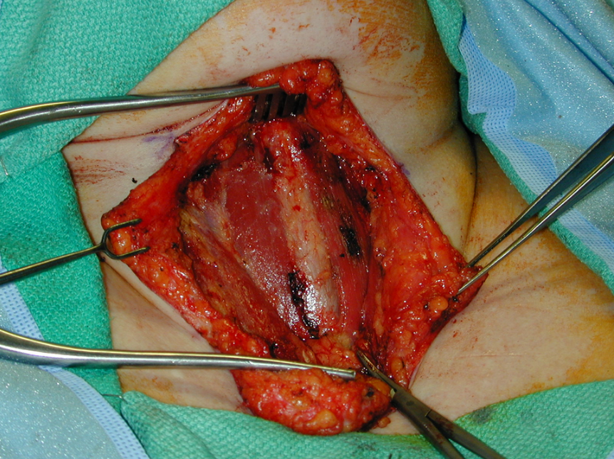
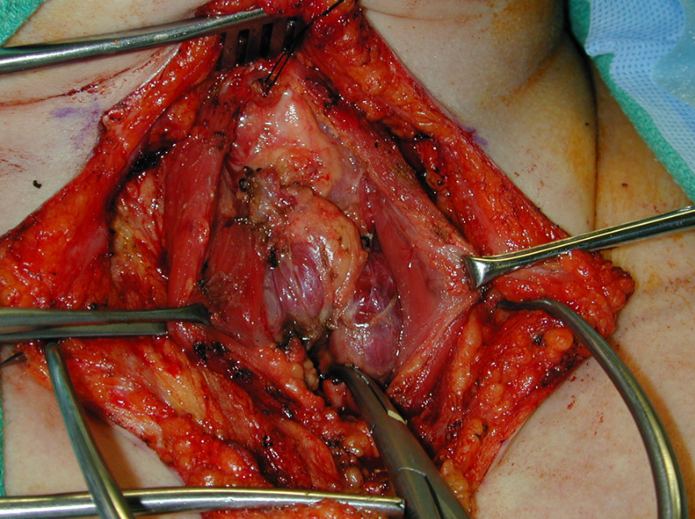
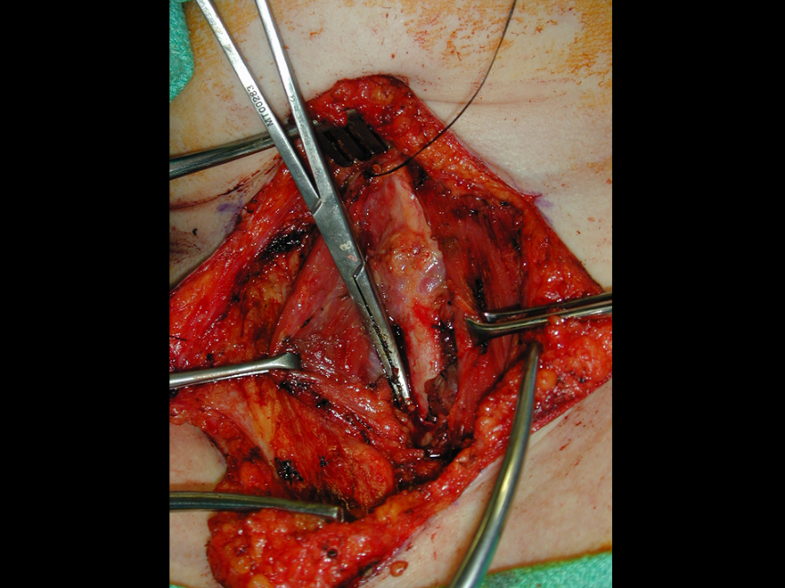
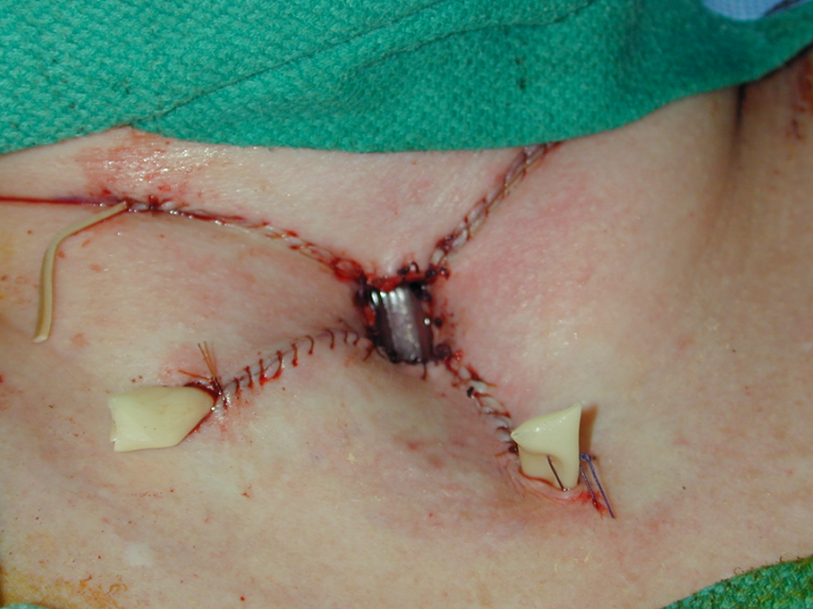

Slide 5
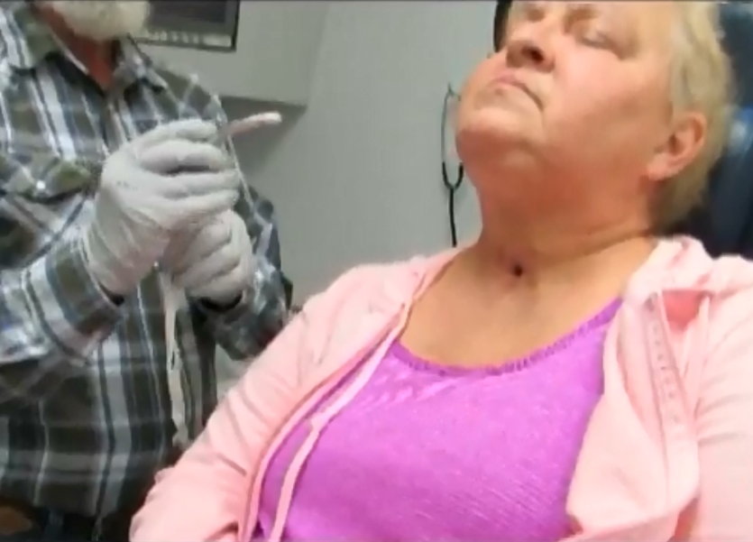
Concept: Post-op tracheostomy care is complicated and take time
Ensure tracheostomy changes occur at
appropriate intervals
Ensure family members or care givers
are trained in trach care
https://medicine.uiowa.edu/iowaprotocols/tracheotomy-change-clinic-videos

Slide 6
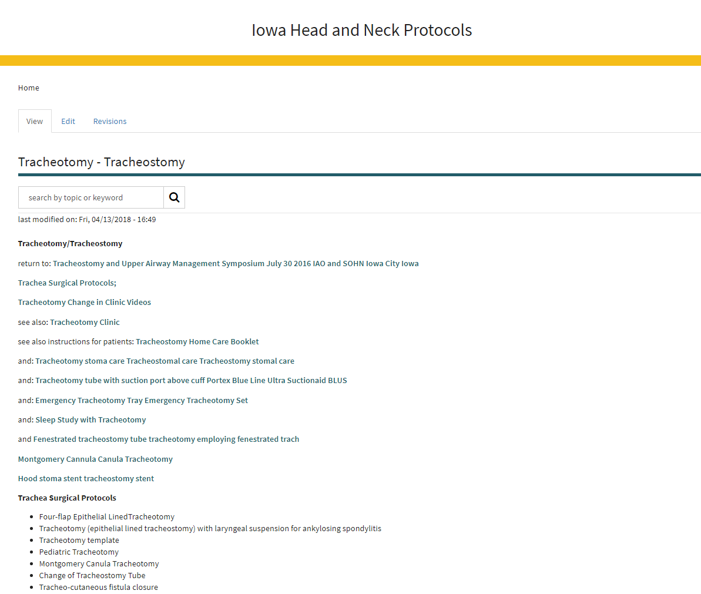
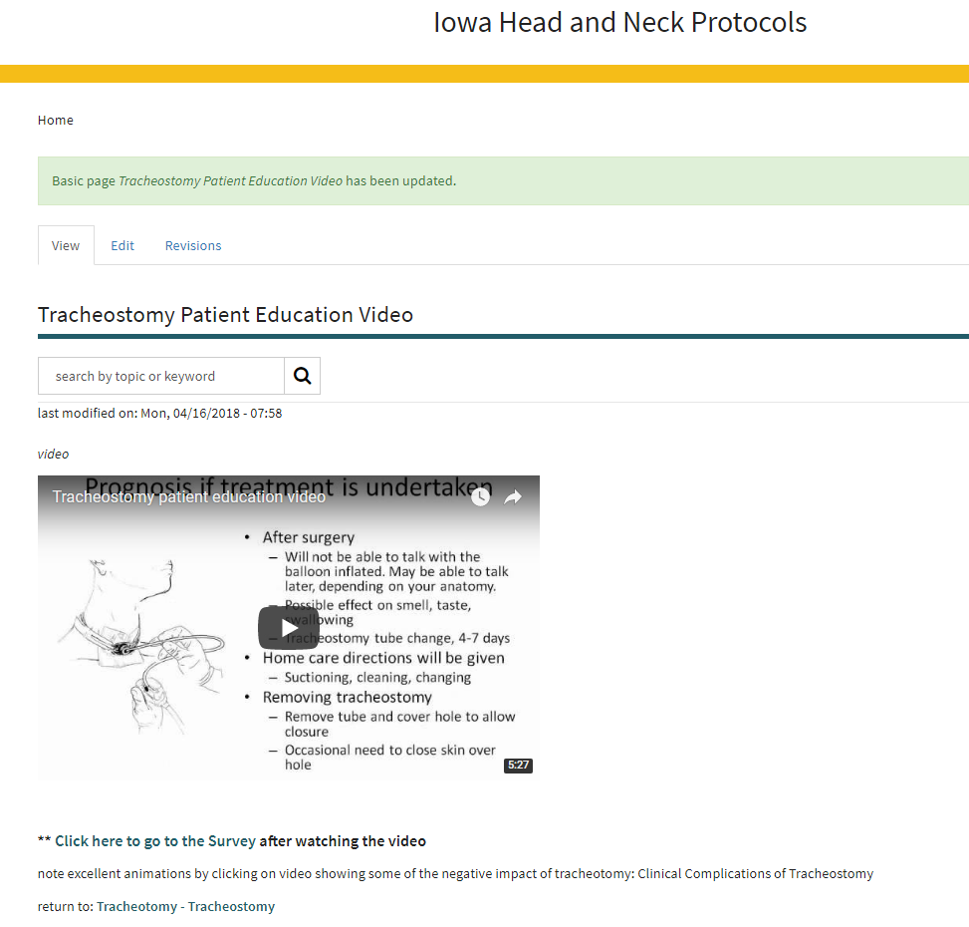
Concept: Post-op tracheostomy care is complicated and take time
3. Provide Educational Materials
https://medicine.uiowa.edu/iowaprotocols/tracheostomy-patient-education-video
https://medicine.uiowa.edu/iowaprotocols/tracheotomy-tracheostomy

Slide 7
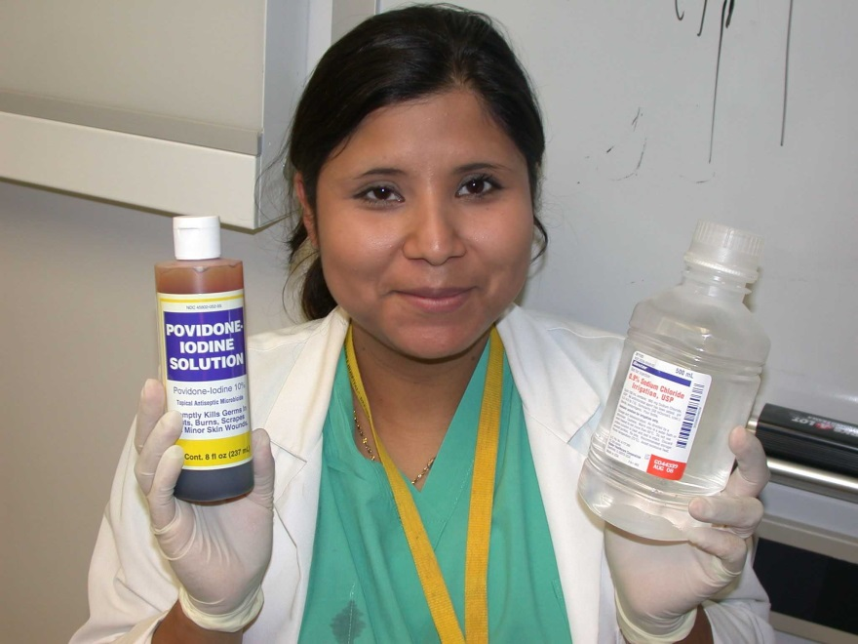
Concept: Post-op tracheostomy care is complicated and take time
4. Maintain long-term followup and involve patient in tracheostomy care

Slide 8
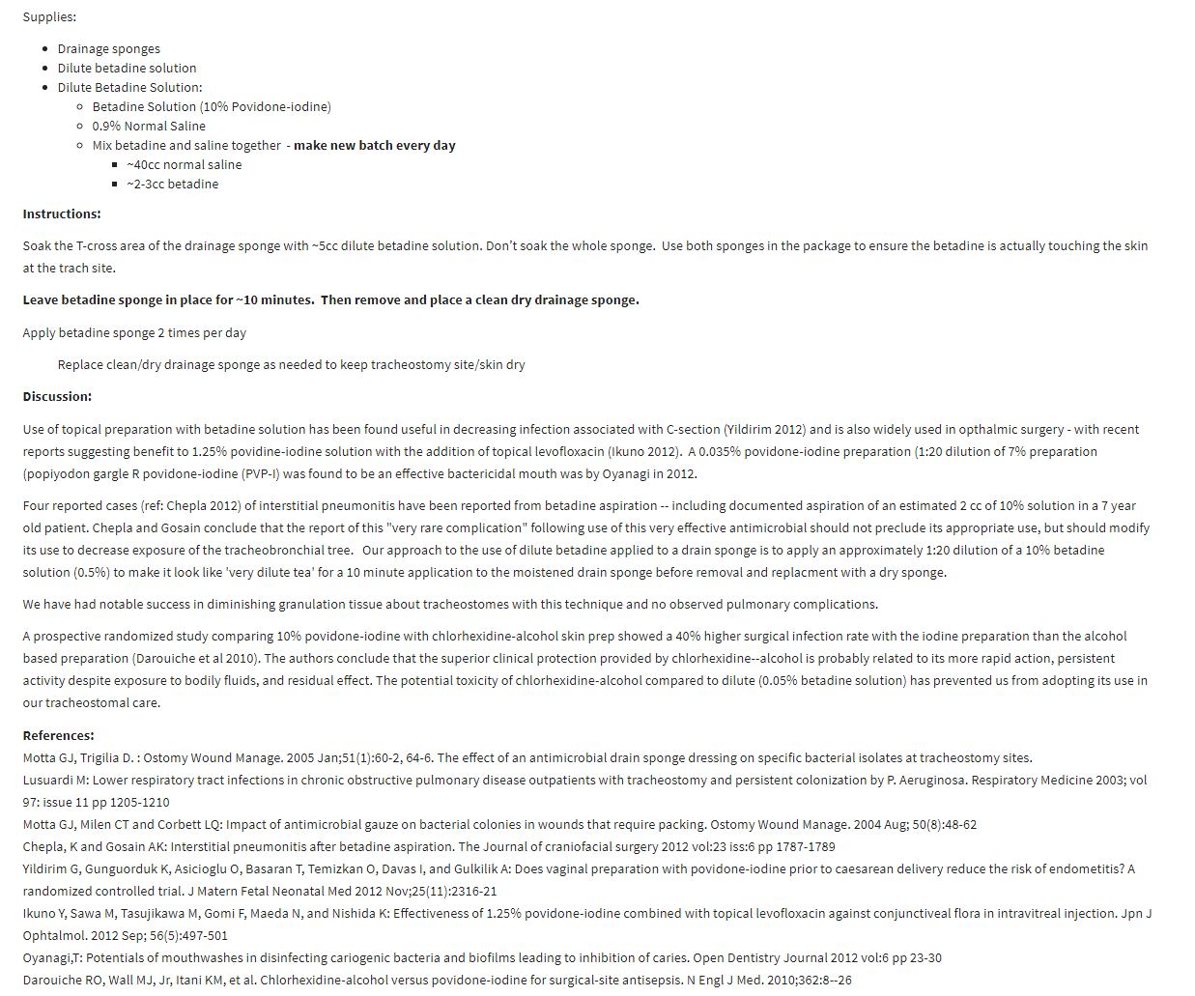

Slide 9
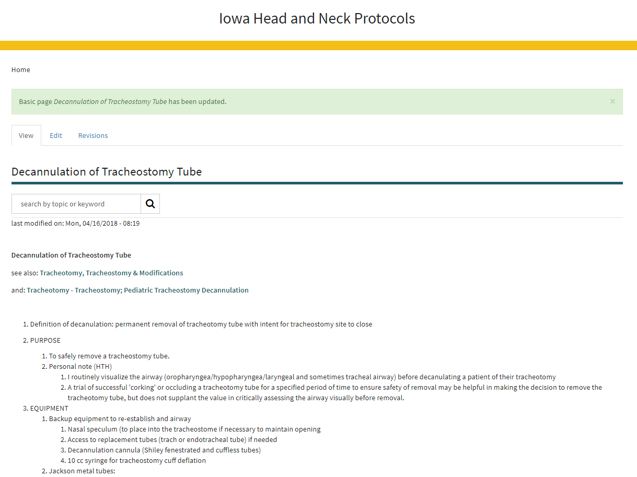
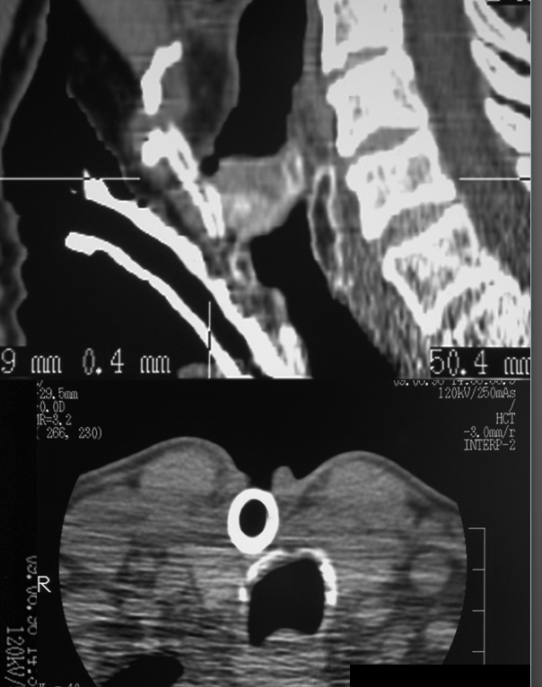
Concept: Post-op tracheostomy care is complicated and take time
5. Re-assess need for tracheostomy with each visit and discuss options
not requiring
tracheotomy

Slide 10
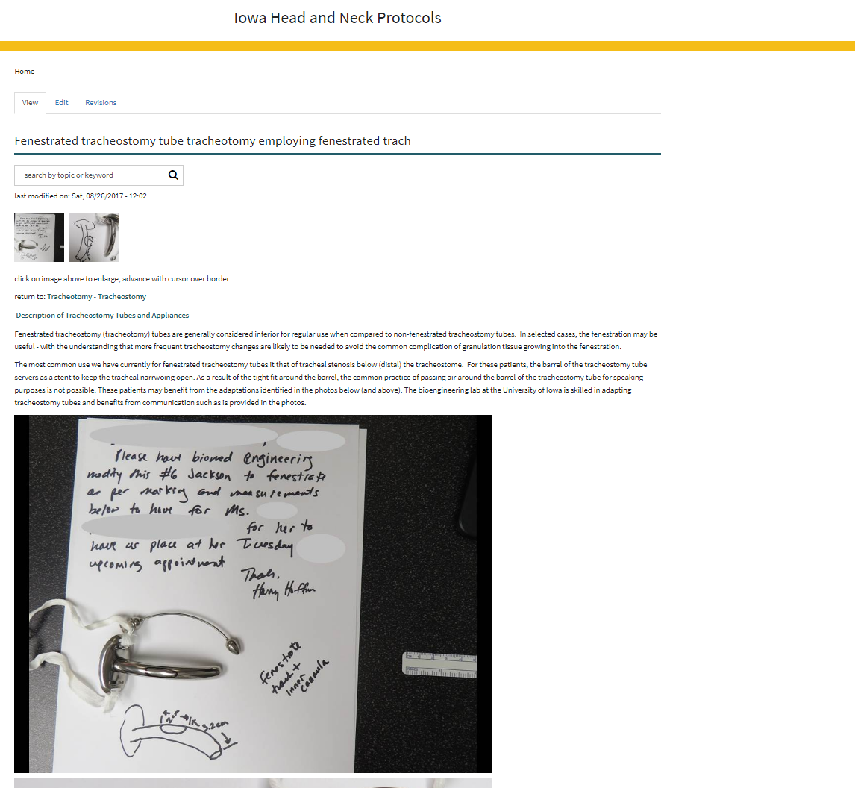
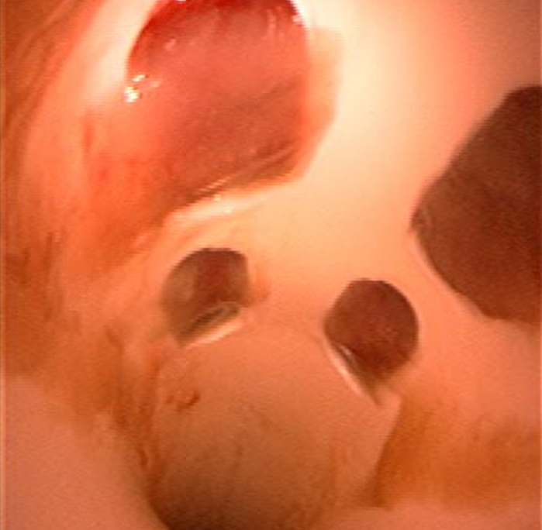
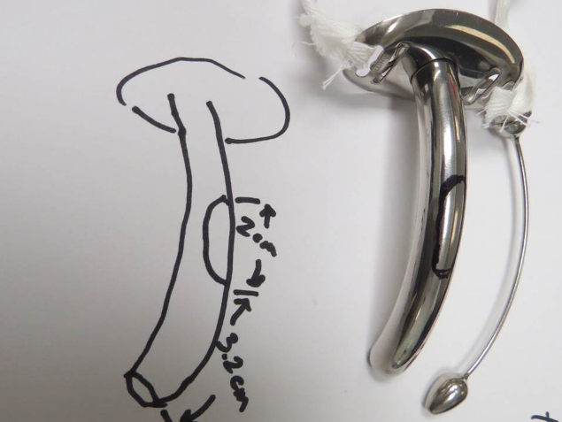
Concept: Modifications to airway prosthesis to improve quality of life
granulation tissue in
complex fenestrated trach

Slide 11
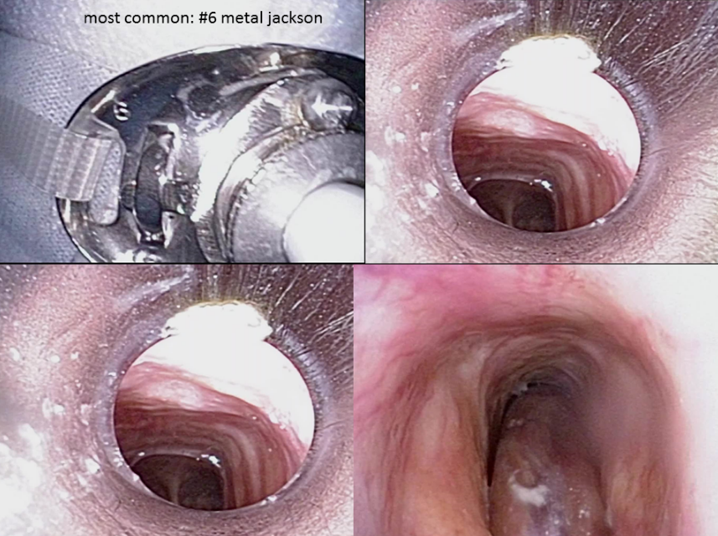
Concept: There are many options to improve the quality of life with a tracheostomy
U of Iowa –most common = metal #6 Jackson

Slide 12
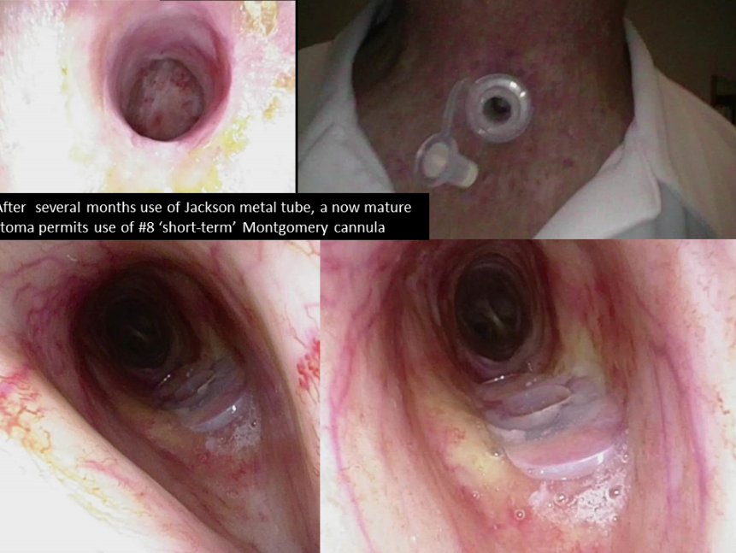
If the stoma is stable, the patient dexterous and knowledgeable, a silicone cannula (Montgomery shown her) may be used

Slide 13
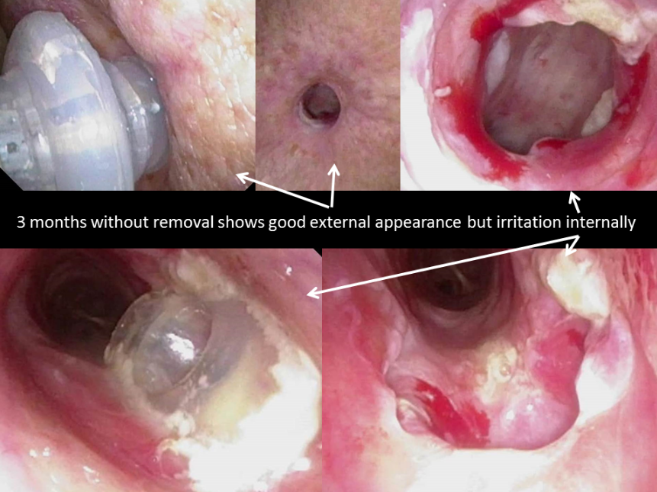

Slide 14
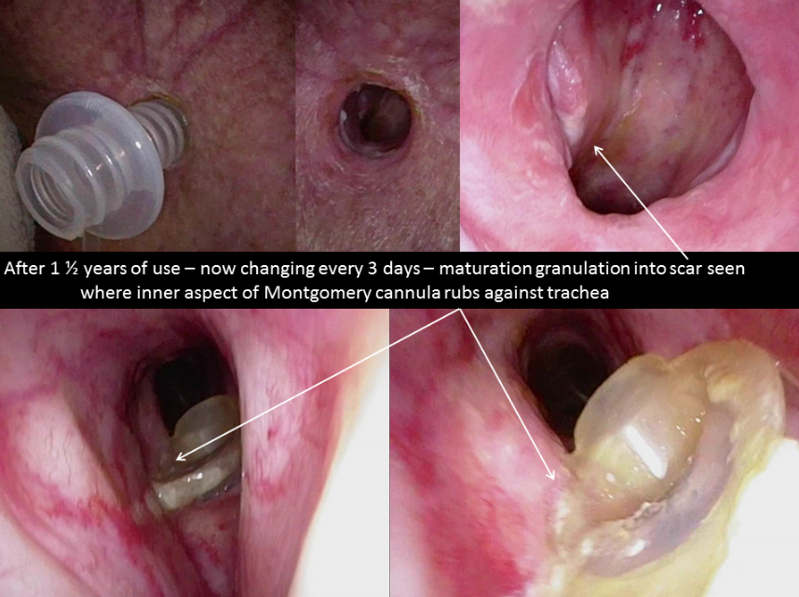

Slide 16
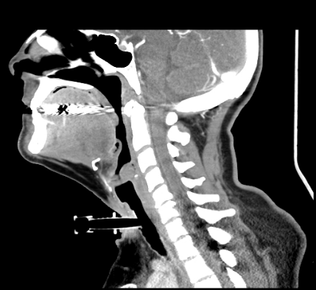
Concept: There are many options to improve the quality of life with a tracheostomy
https://medicine.uiowa.edu/iowaprotocols/montgomery-cannula-canula-tracheotomy
https://medicine.uiowa.edu/iowaprotocols/montgomery-cannula-canula-insertion-clinic

Slide 17
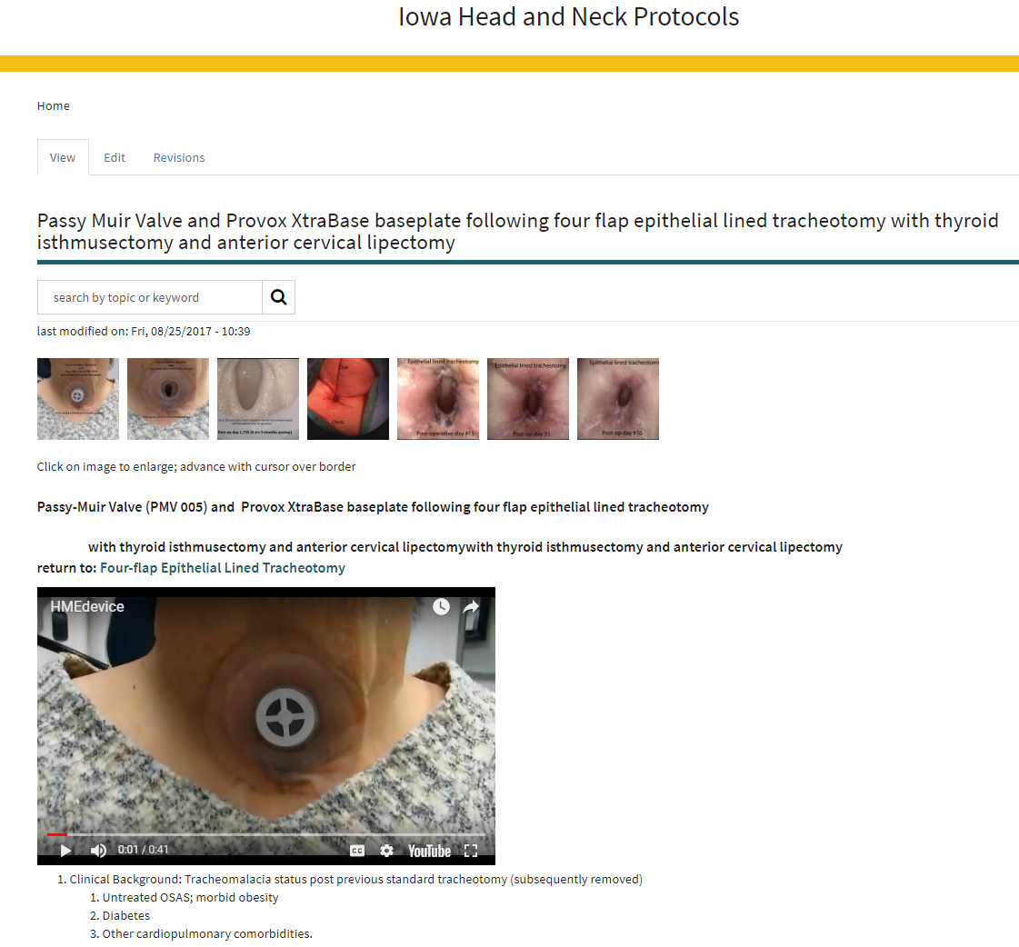
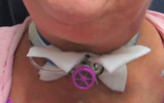
Concept: There are many options to improve the quality of life with a tracheostomy
Involve Speech Pathology
for initiation and care of
speaking valves and
adhesive plates

Slide 18
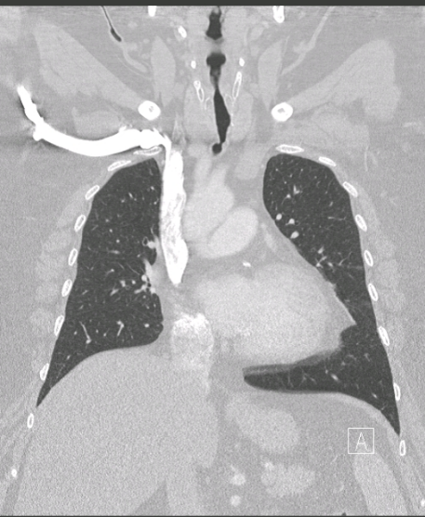
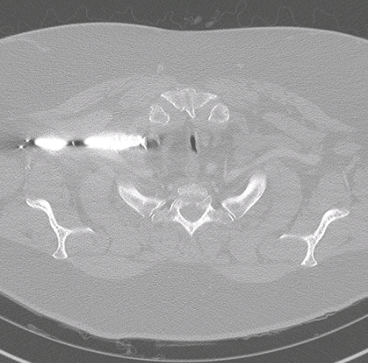
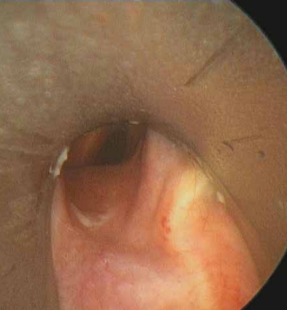
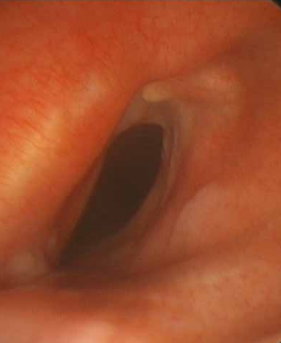
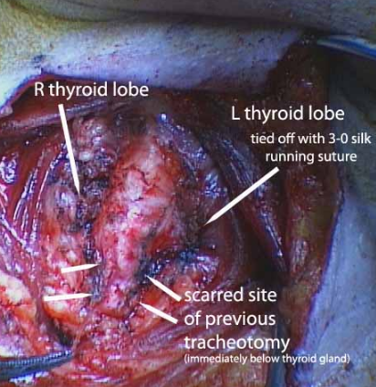
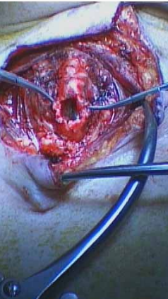
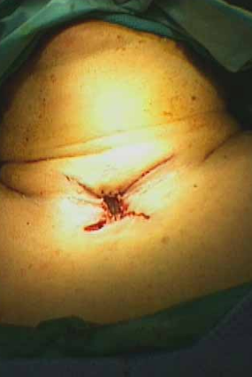
Prevention / Treatment
“A-Frame” narrowing at site of previous trach

Slide 19
ABEA
Panel II: Trach Lore: Options, Management and Modifications of Airway Prosthesis
Moderator: Paul C Bryson
Panelists: James Daniero Alexander Gelbard Harry Hoffman Christopher Wooten
Thursday April 19, 2018
Maryland B Room
HEADQUARTERS HOTEL
Gaylord National Resort & Convention Center 201 Waterfront Street
National Harbor, MD 20745
301-965-4000

