Slide 1
Salivary Gland Anatomic Anomalies and Foreign Bodies
AHNS Salivary Endoscopy Course
Nicholson Center Orlando, Florida
April 9, 2013
Harry Hoffman MD MS
3,000 page handout with videos/photos: search for “Iowa Protocols”
search: “AHNS Salivary Lectures 2013”

Slide 2
Disclosures
None

Slide 3
Anatomic Anomalies
Parotid:
Normal ductal system
Accessory lobe
Anomalous drainage acquired and congenital
Submandibular
Relationship to lingual nerve and sublingual gland
Sublingual
Ducts of Rivinus
Bartholin’s duct

Slide 4
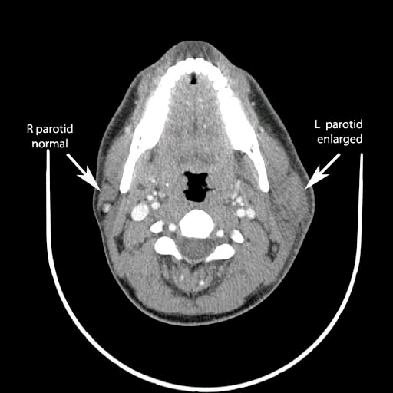
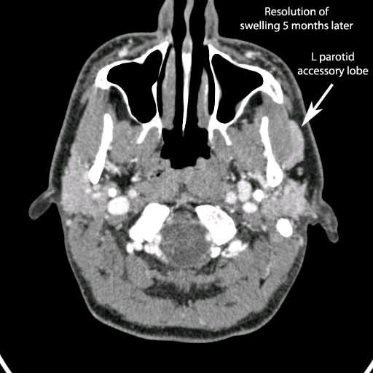
Anatomic Anomalies
Parotid: Normal ductal system / Accessory Lobe

Slide 5
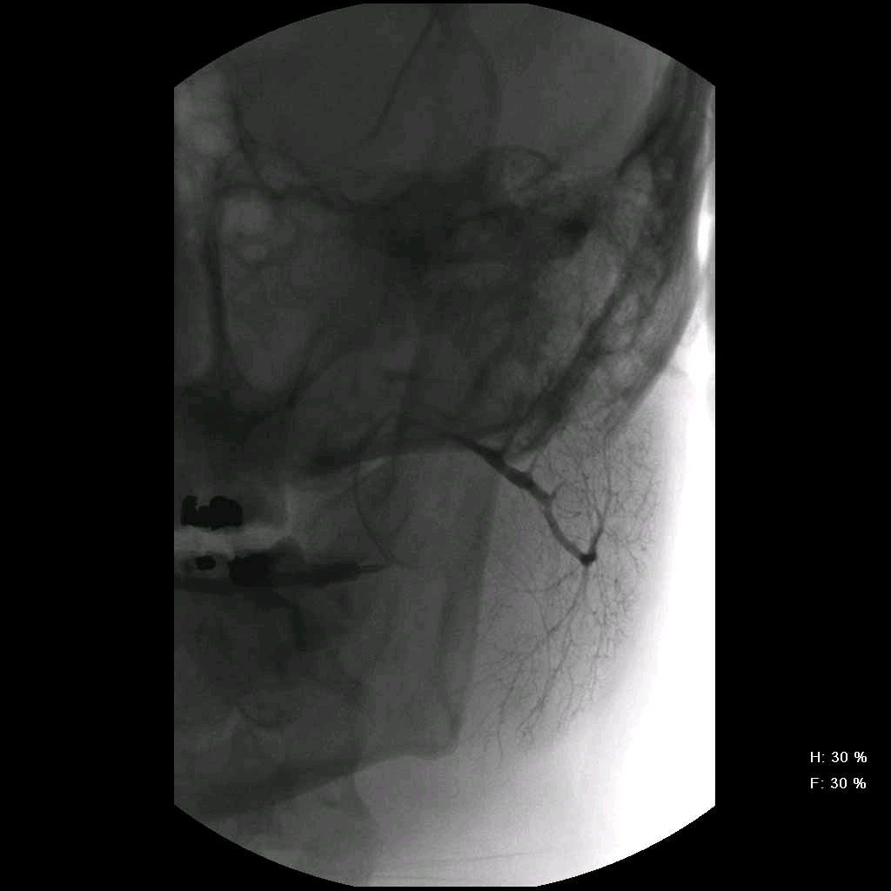
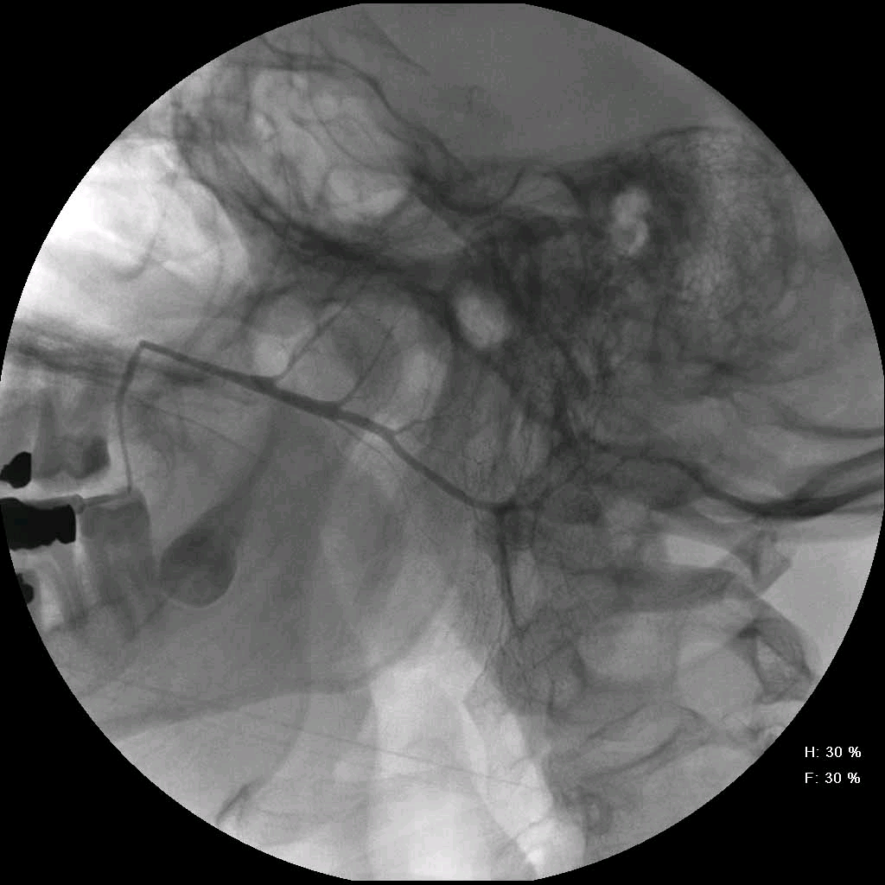
Anatomic Anomalies
Parotid: Normal ductal system / Accessory Lobe

Slide 6
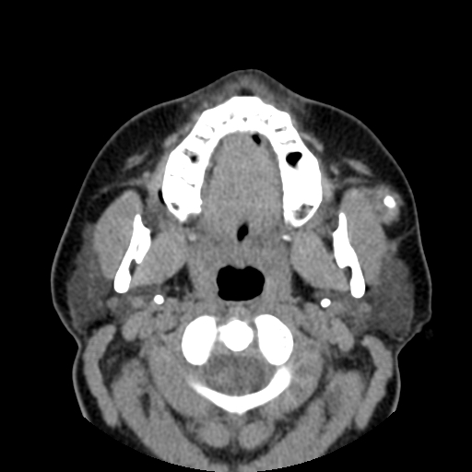
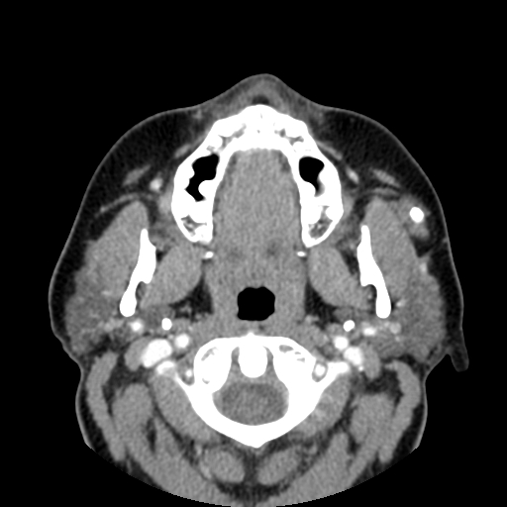
Anatomic Anomalies
Parotid: Accessory Lobe Stone

Slide 7
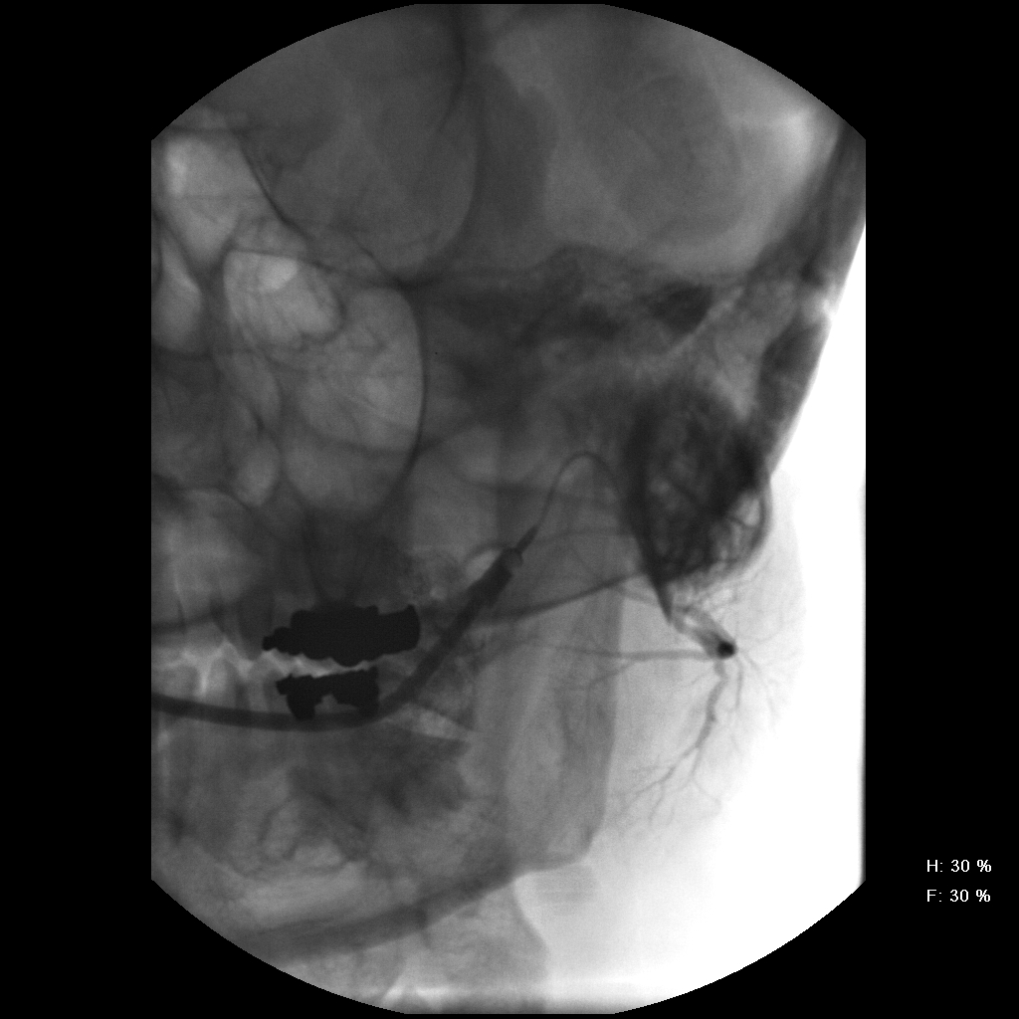
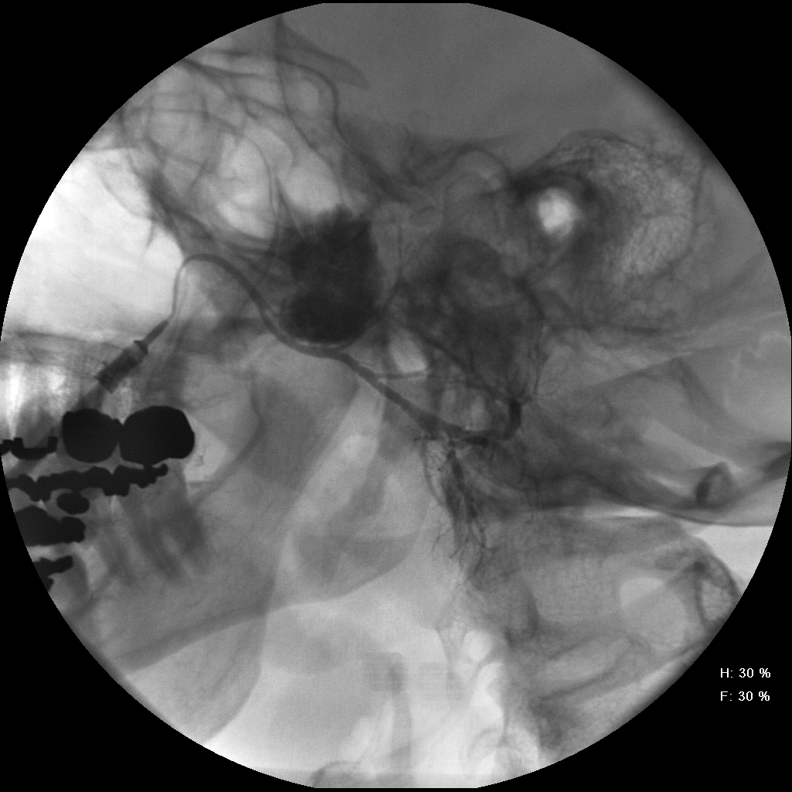
Anatomic Anomalies
Parotid: Accessory Lobe Stone

Slide 8
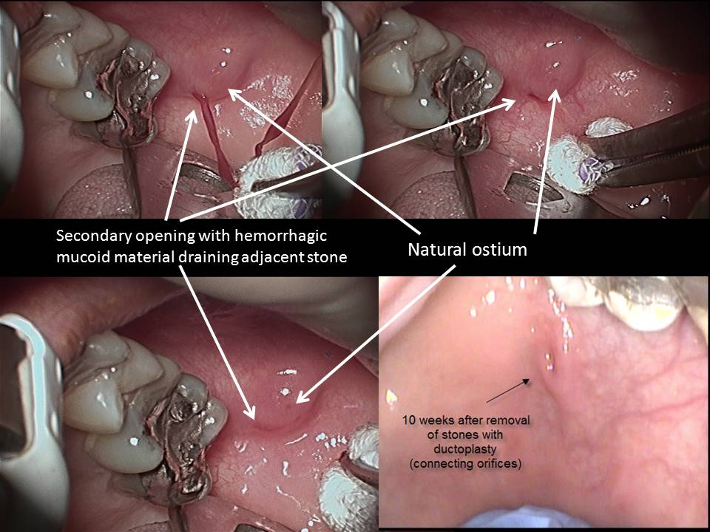
Anatomic Anomalies
Parotid: Anomalous drainage acquired and congenital

Slide 9
Anatomic Anomalies
Submandibular
Relationship to lingual nerve and sublingual gland
Sublingual
Ducts of Rivinus
Bartholin’s duct

Slide 10
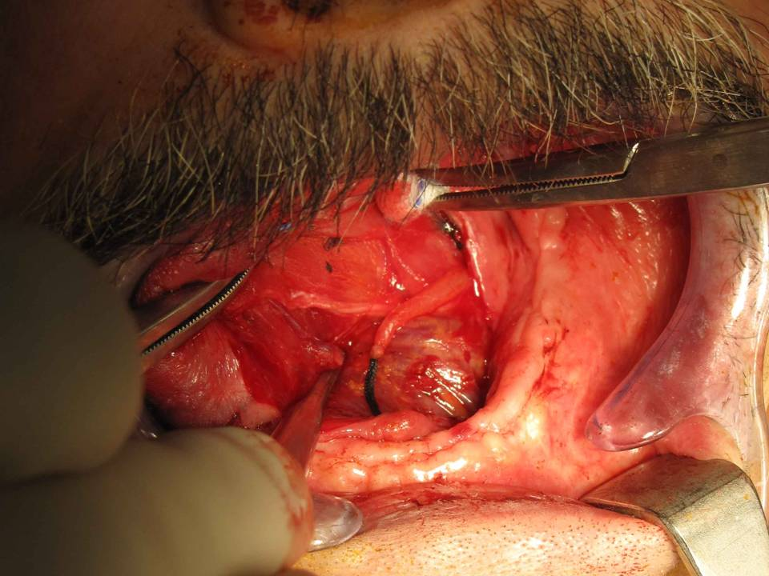
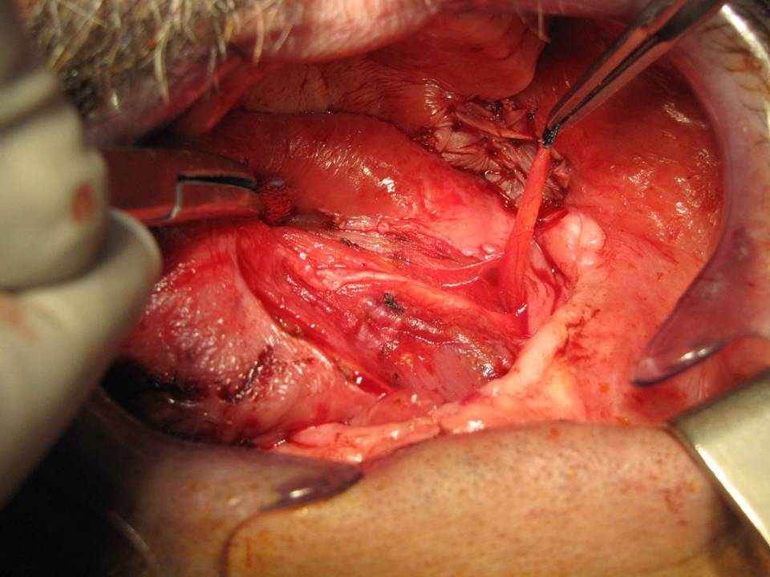
Anatomic Anomalies
Submandibular
Relationship to lingual nerve and sublingual gland

Slide 11
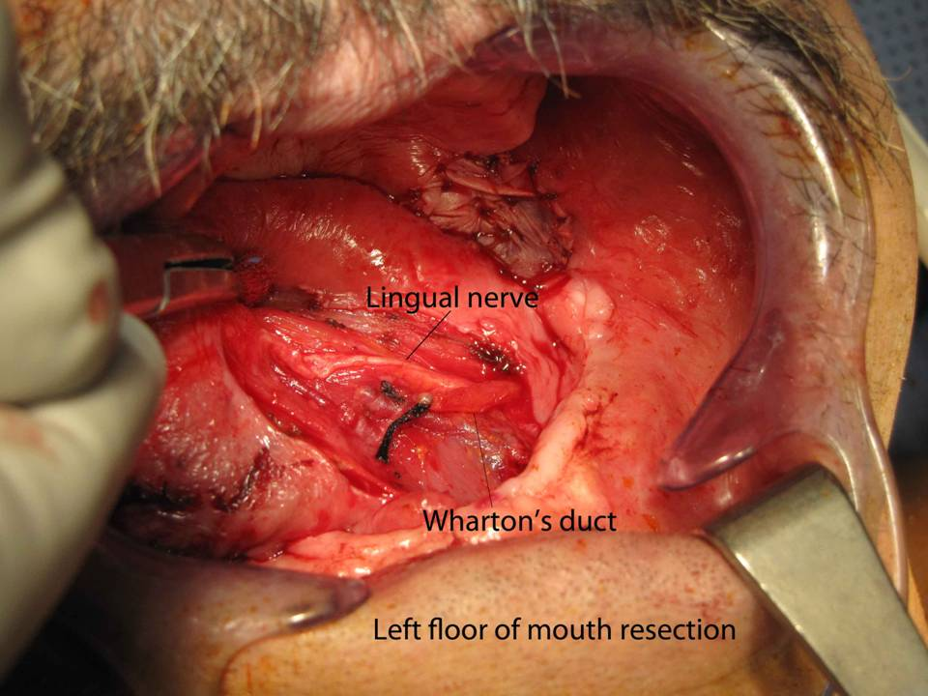

Slide 12
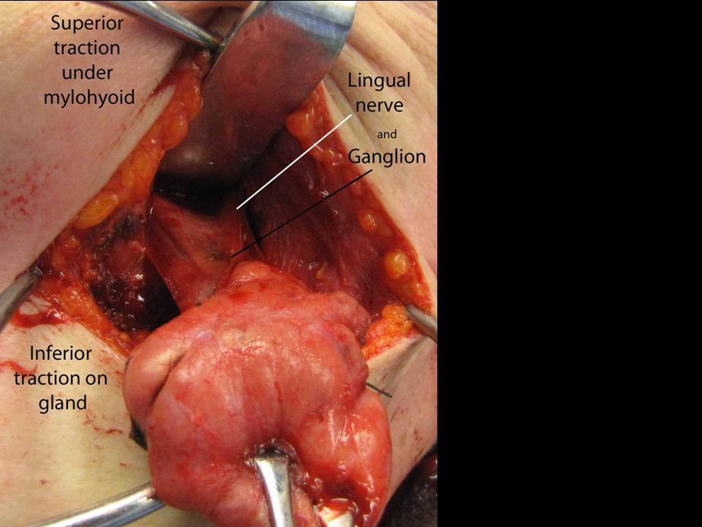

Slide 15
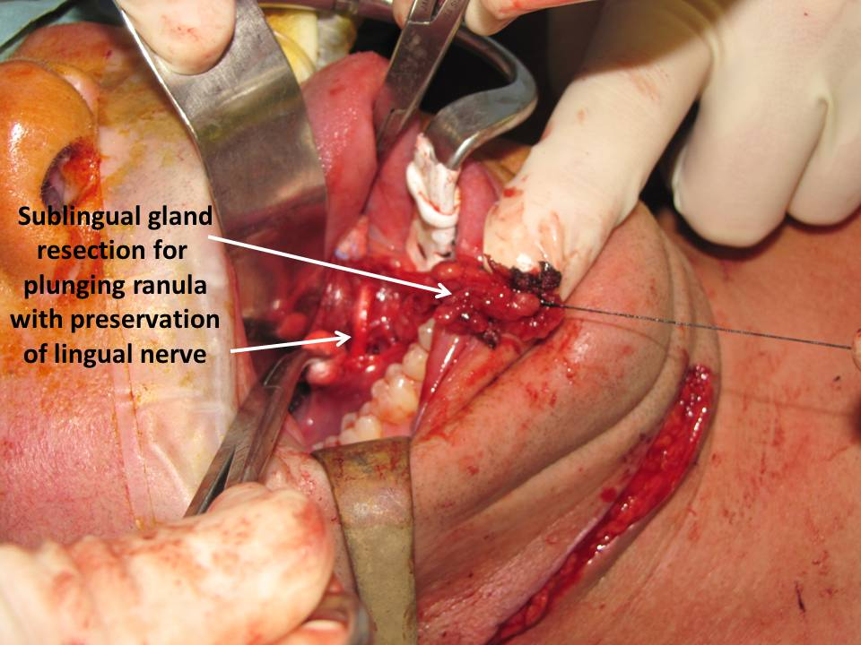
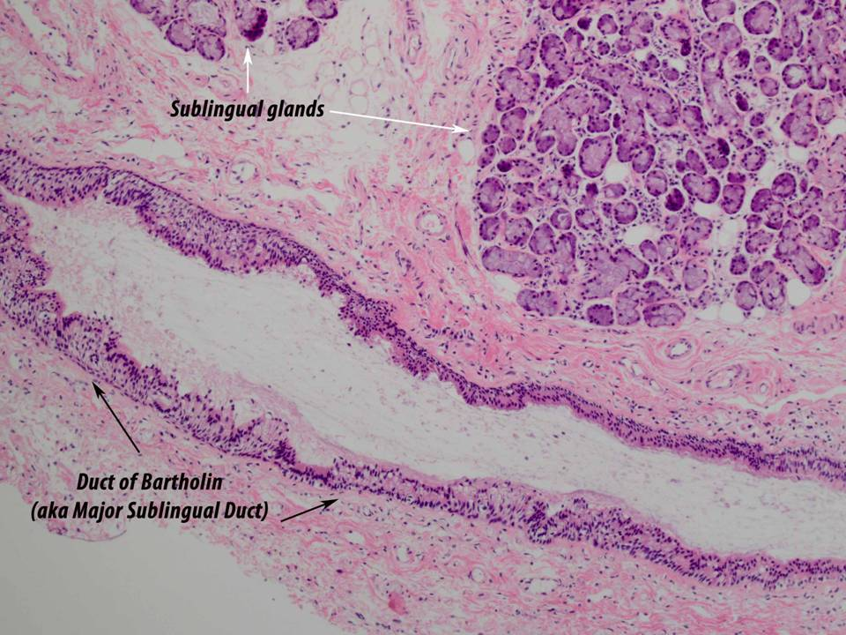
Anatomic Anomalies
Sublingual glands secrete directly
through mucosa into FOM via multipel ducts of Rivinus
and
Bartholin’s duct that empties into the Wharton’s duct

Slide 16
Salivary Foreign Bodies
Philosophy: Endogenous v Exogenous
Sialolithiasis theories:
1.Intracellular microcalculi excreted in canal as nidus to calcify
2. “Mucus plugs’ as nidus to calcify
3. “aliments, substances, or bacteria in the oral cavity migrate into the salivary ducts for further calcification”
Marchal et al: Retrograde Theory in Sialolithiasis Formation arch Otolaryngol 127, Jan 2001 pp 66-68
Published reports
Su et al: Sialoendoscopic management of submandibular gland obstruction
Caused by intraglandular foreign body. Vol. 114 No. 5 November 2012
Blade of grass | Pin needle | Piece of broom straw
Hair brush thistle | Vegetable fiber | Fingernail
Fish bone | Limb of shrimp | Feather
Shrapnel | Piece of Hair | 5 Cases of Fish Bones
Fish bone | Vegetable nidus | Wood-like strands

Slide 17
Salivary Foreign Body Examples: Parotid: percutaneous welding slag Submandibular: migrated stent (20 gauge angiocatheter)
“google” or “bing” or otherwise search: “Iowa Protocols” then search in the protocols:
“foreign body”
or
“sialendoscopy”

